Slide 1


Slide 2
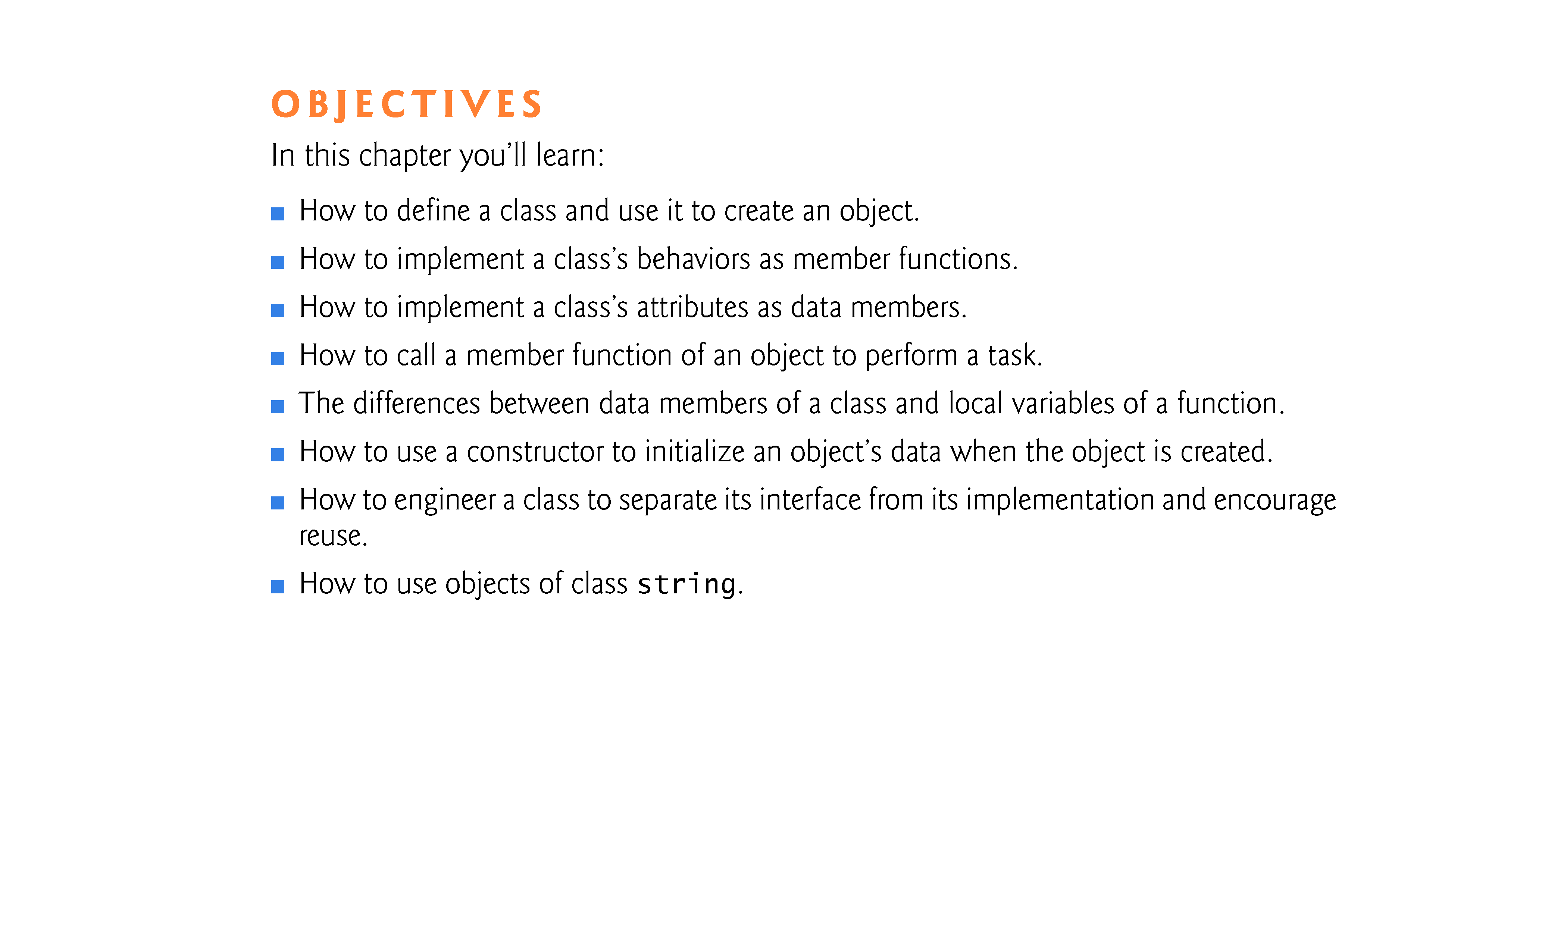

Slide 3
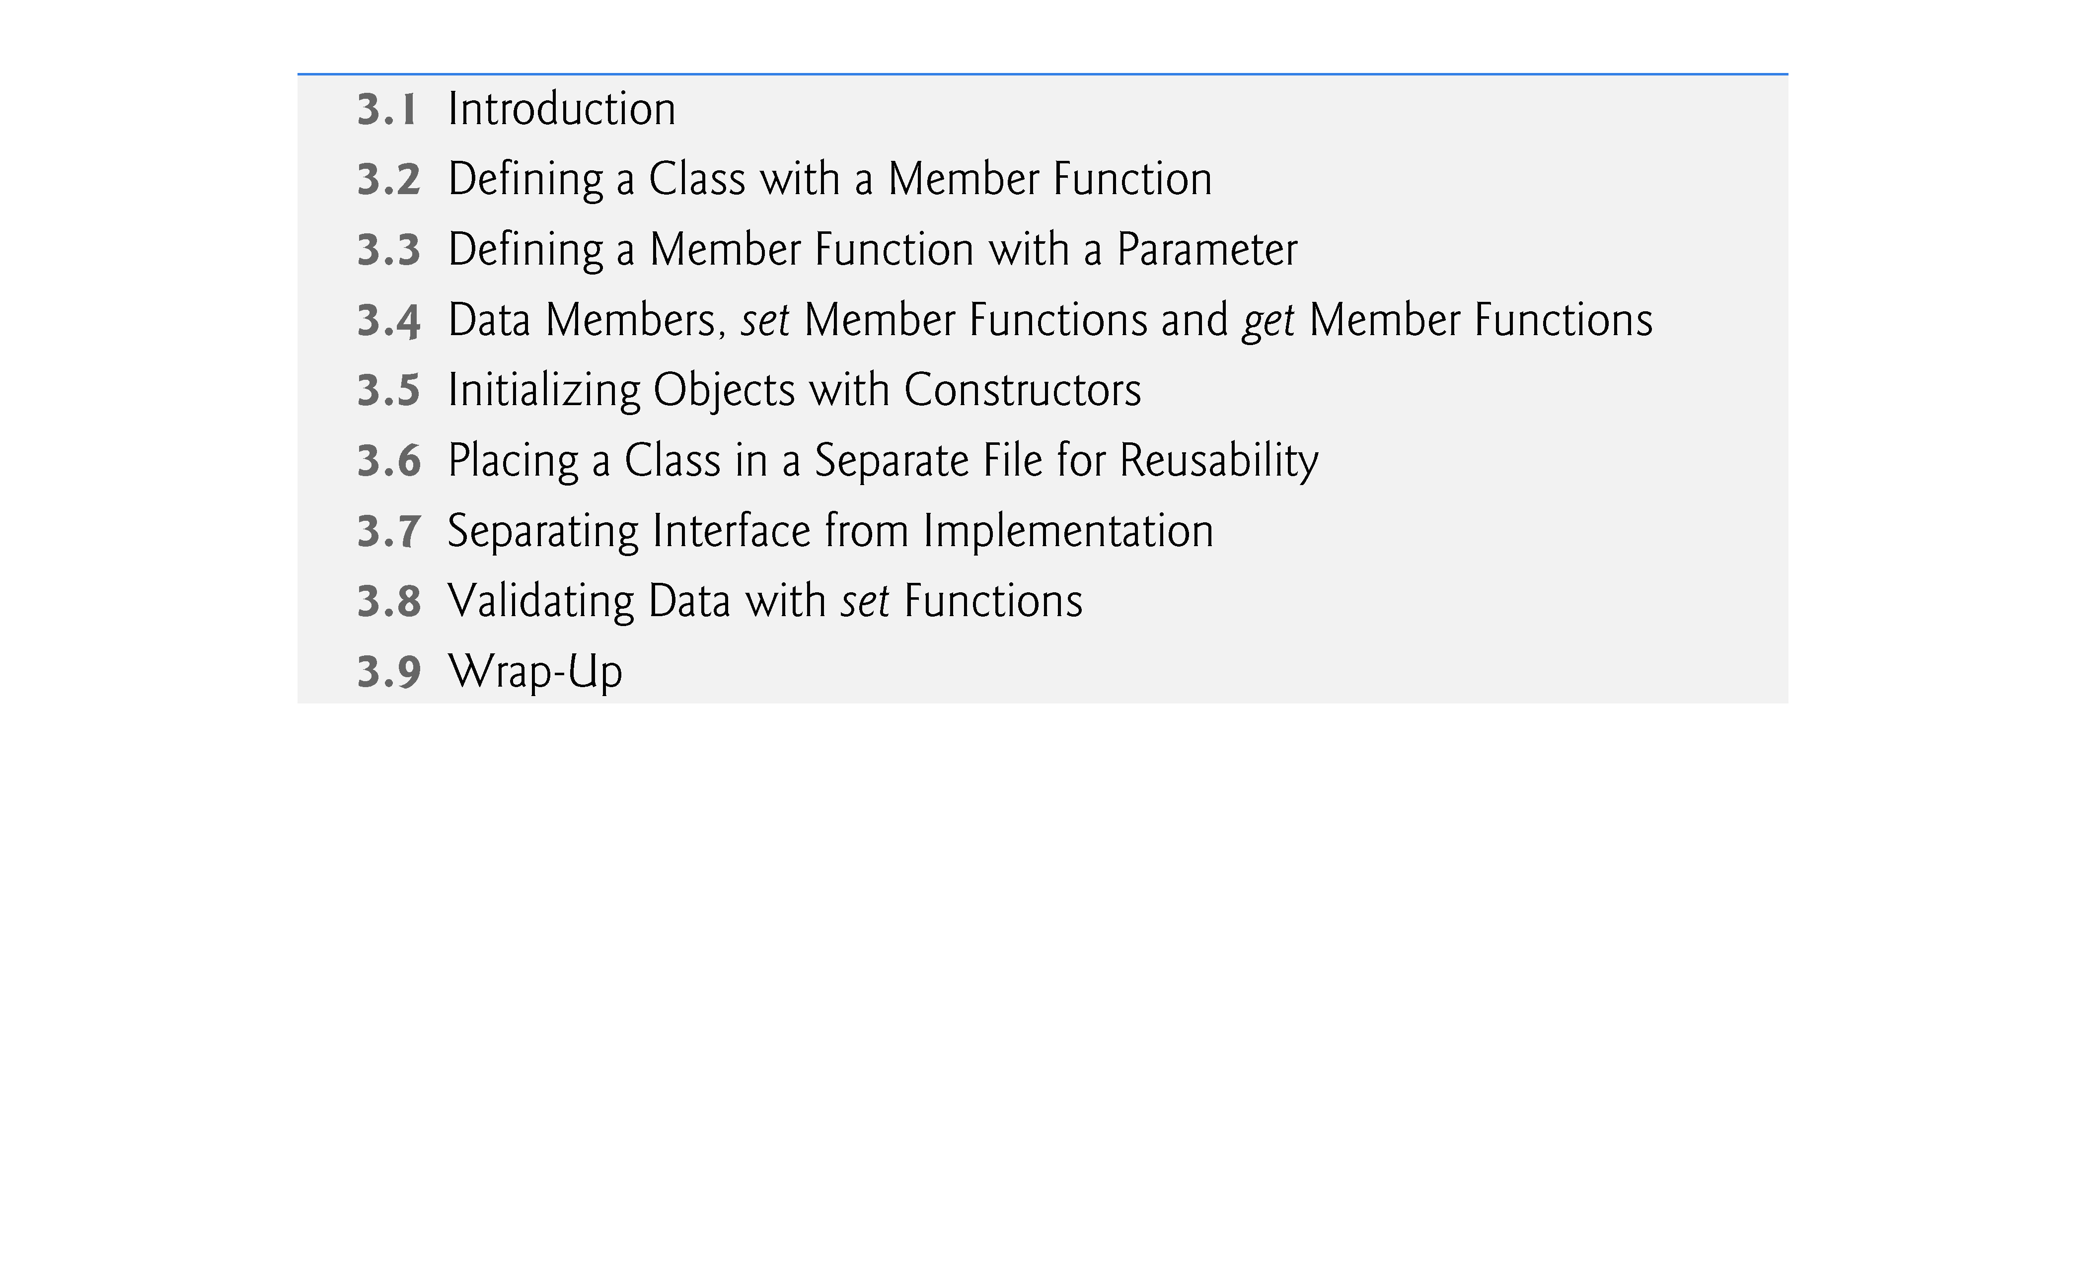

Slide 4
3.1 Introduction
In this chapter, you’ll begin writing programs that employ the basic concepts of object-oriented programming that we introduced in Section 1.8.
Typically, the programs you develop in this book will consist of function main and one or more classes, each containing data members and member functions.
In this chapter, we develop a simple, well-engineered framework for organizing object-oriented programs in C++.

Slide 5
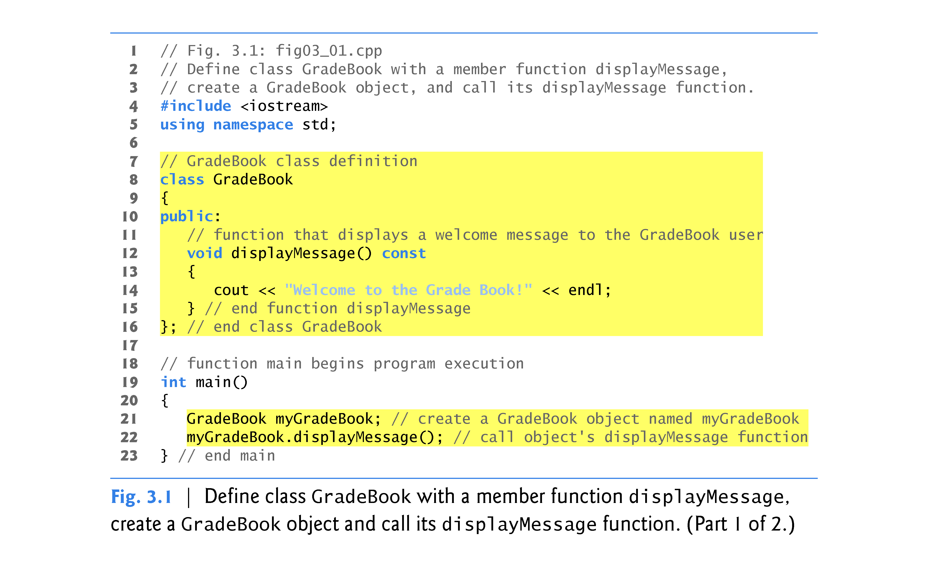

Slide 6
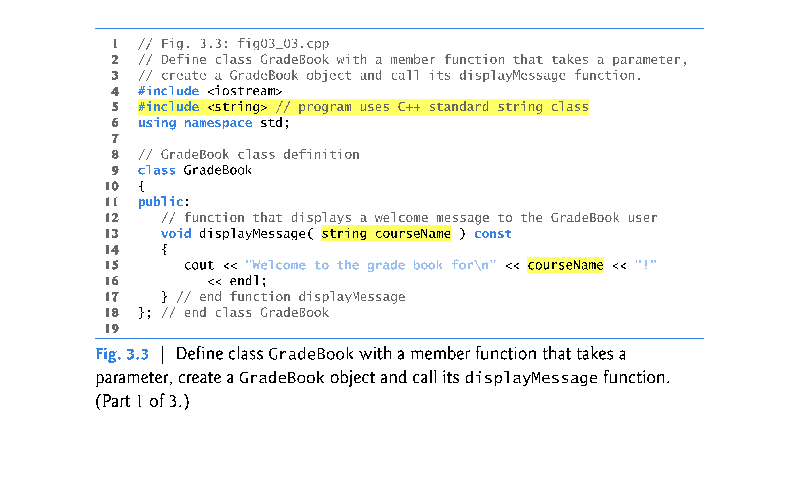

Slide 7
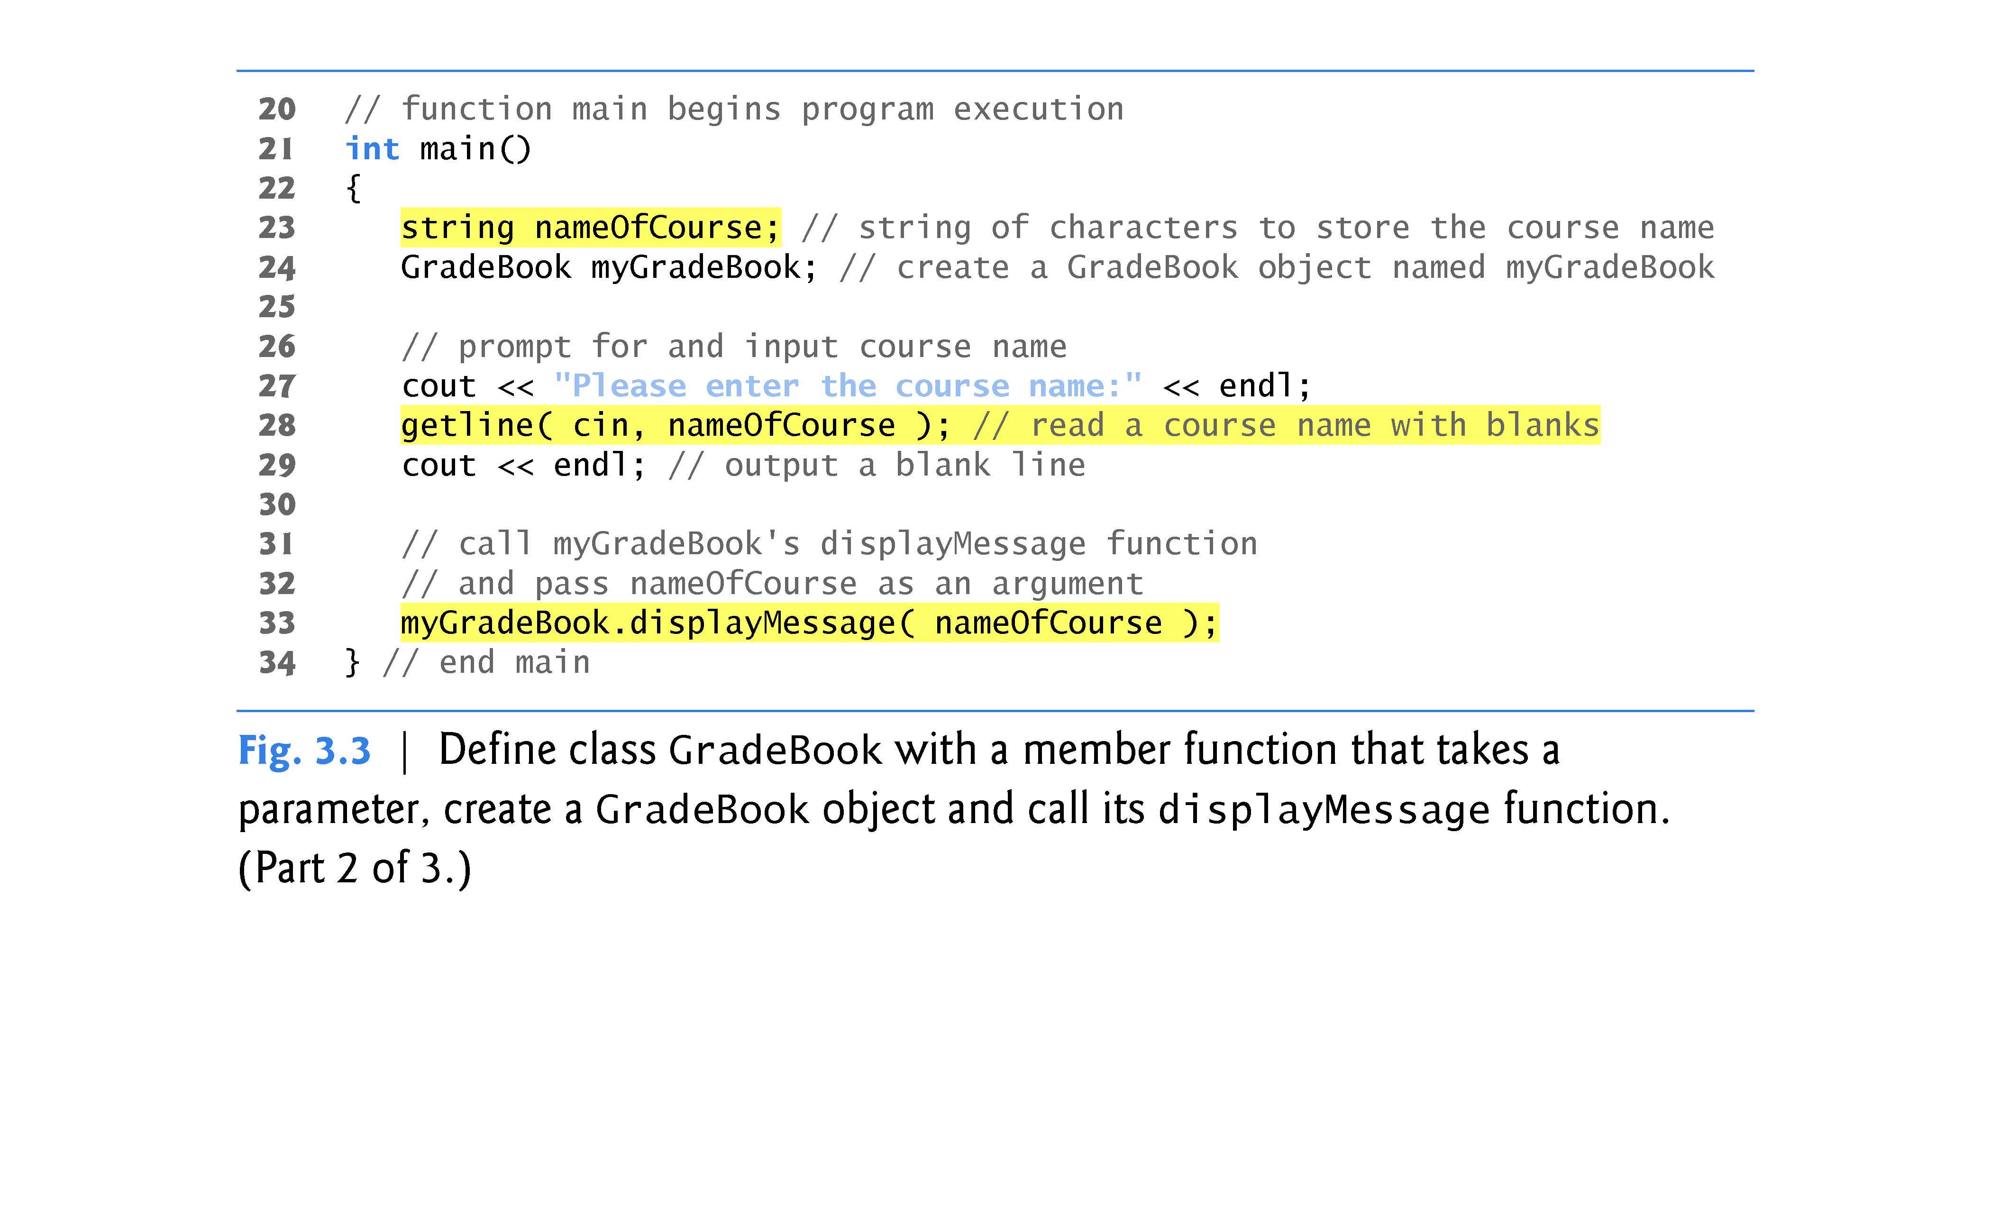

Slide 8
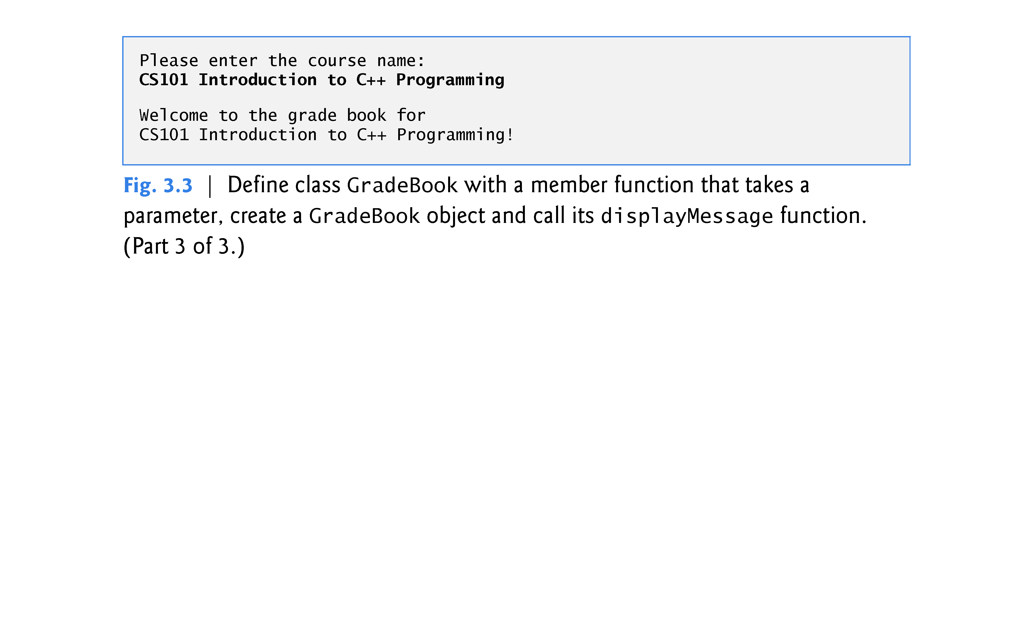

Slide 9
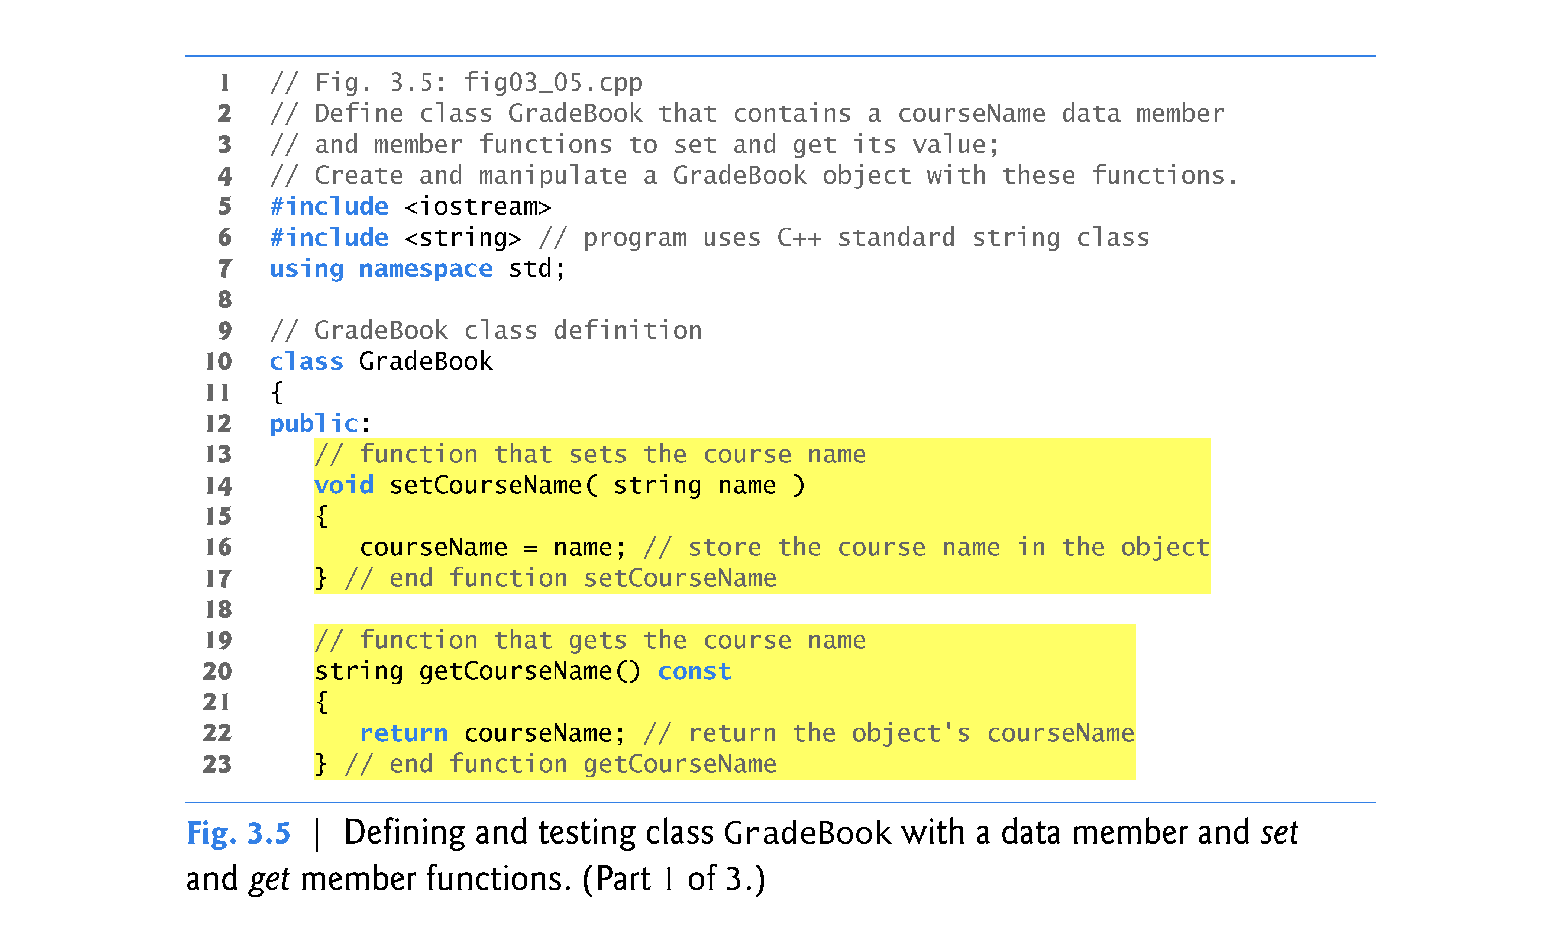

Slide 10
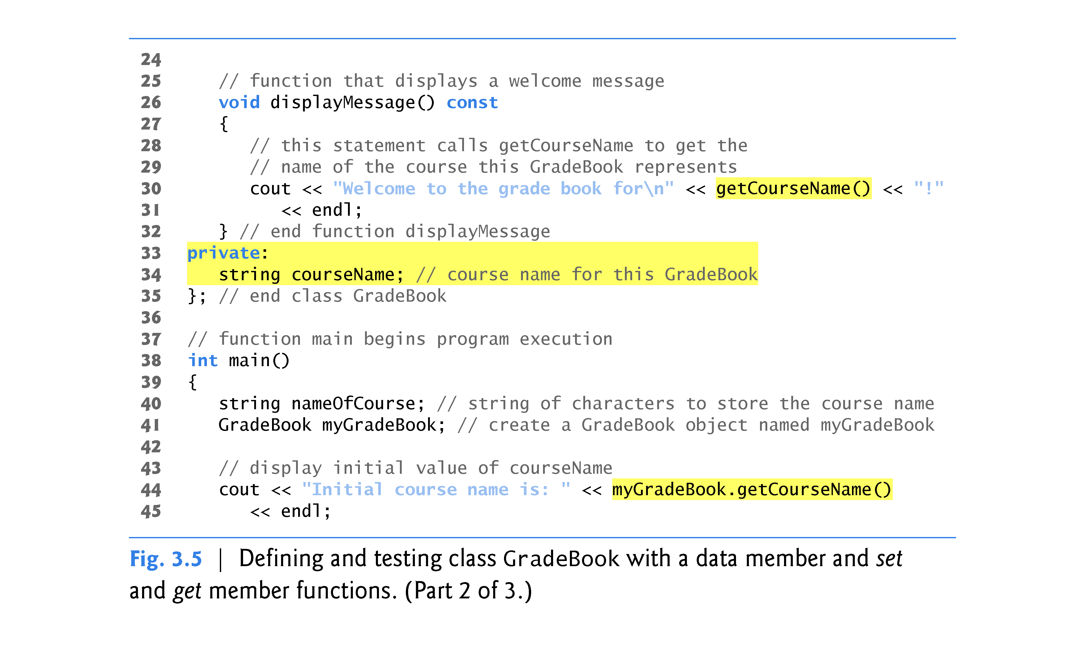

Slide 11
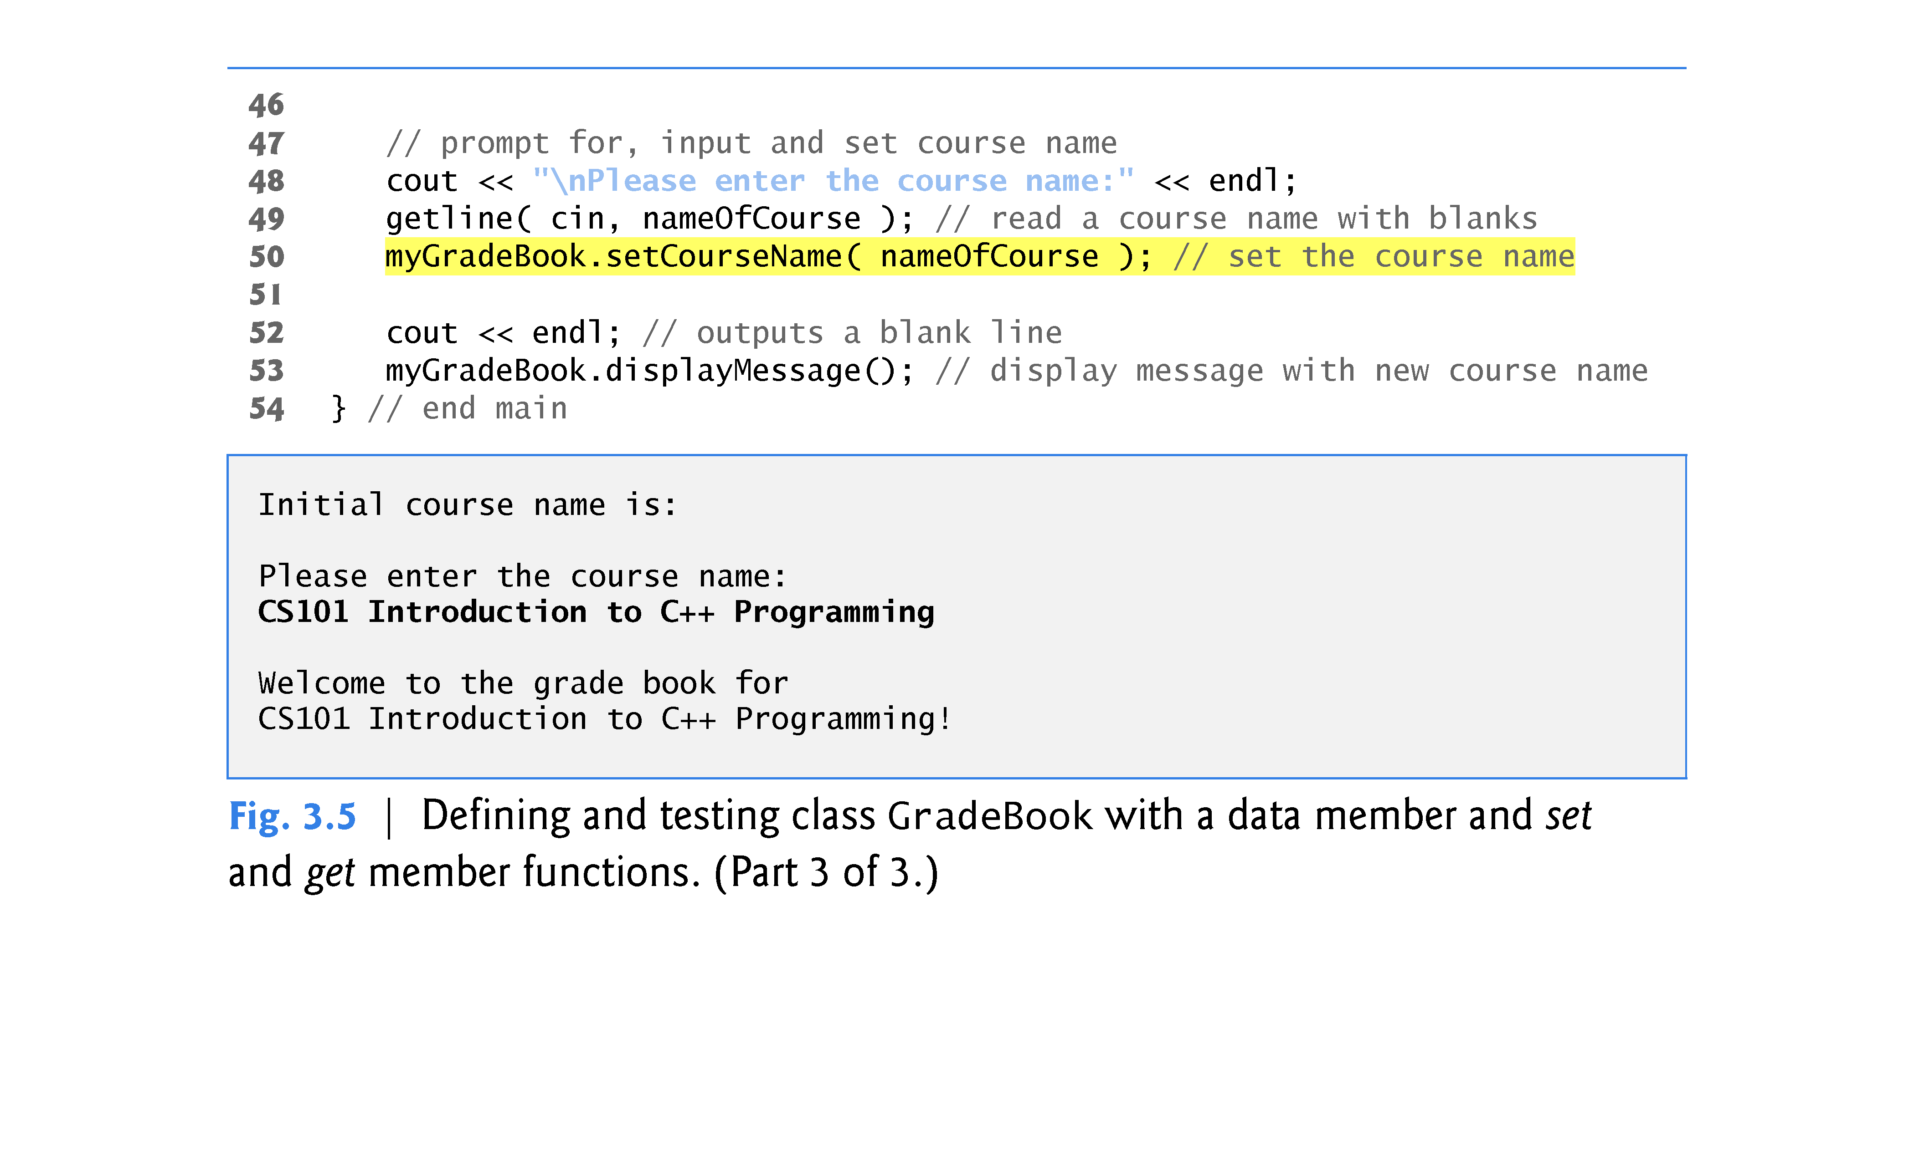

Slide 12
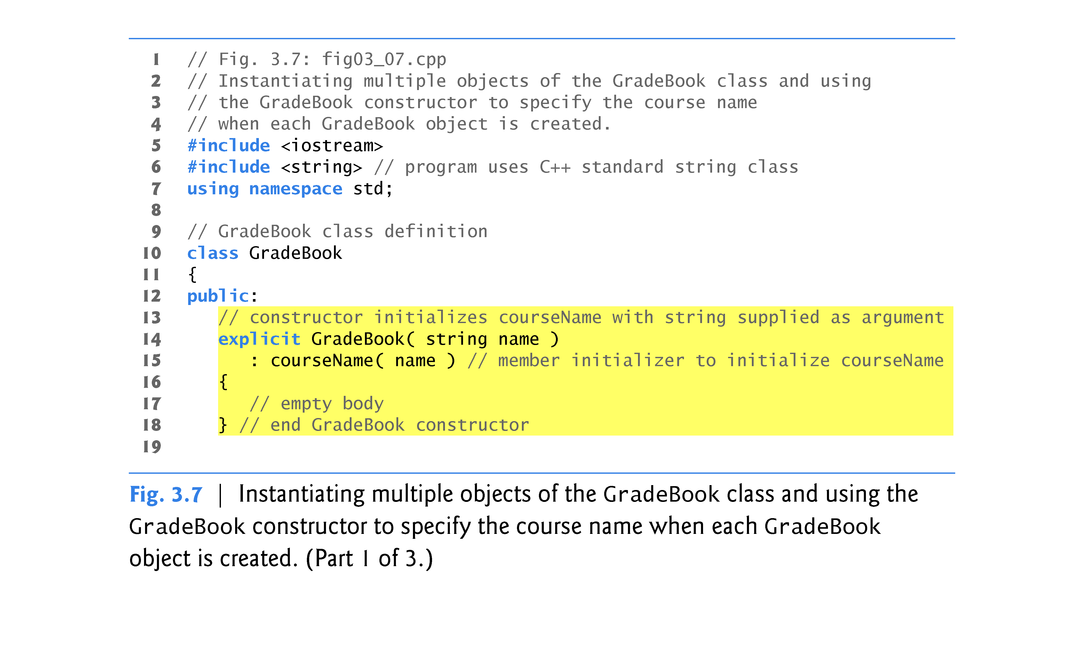

Slide 13
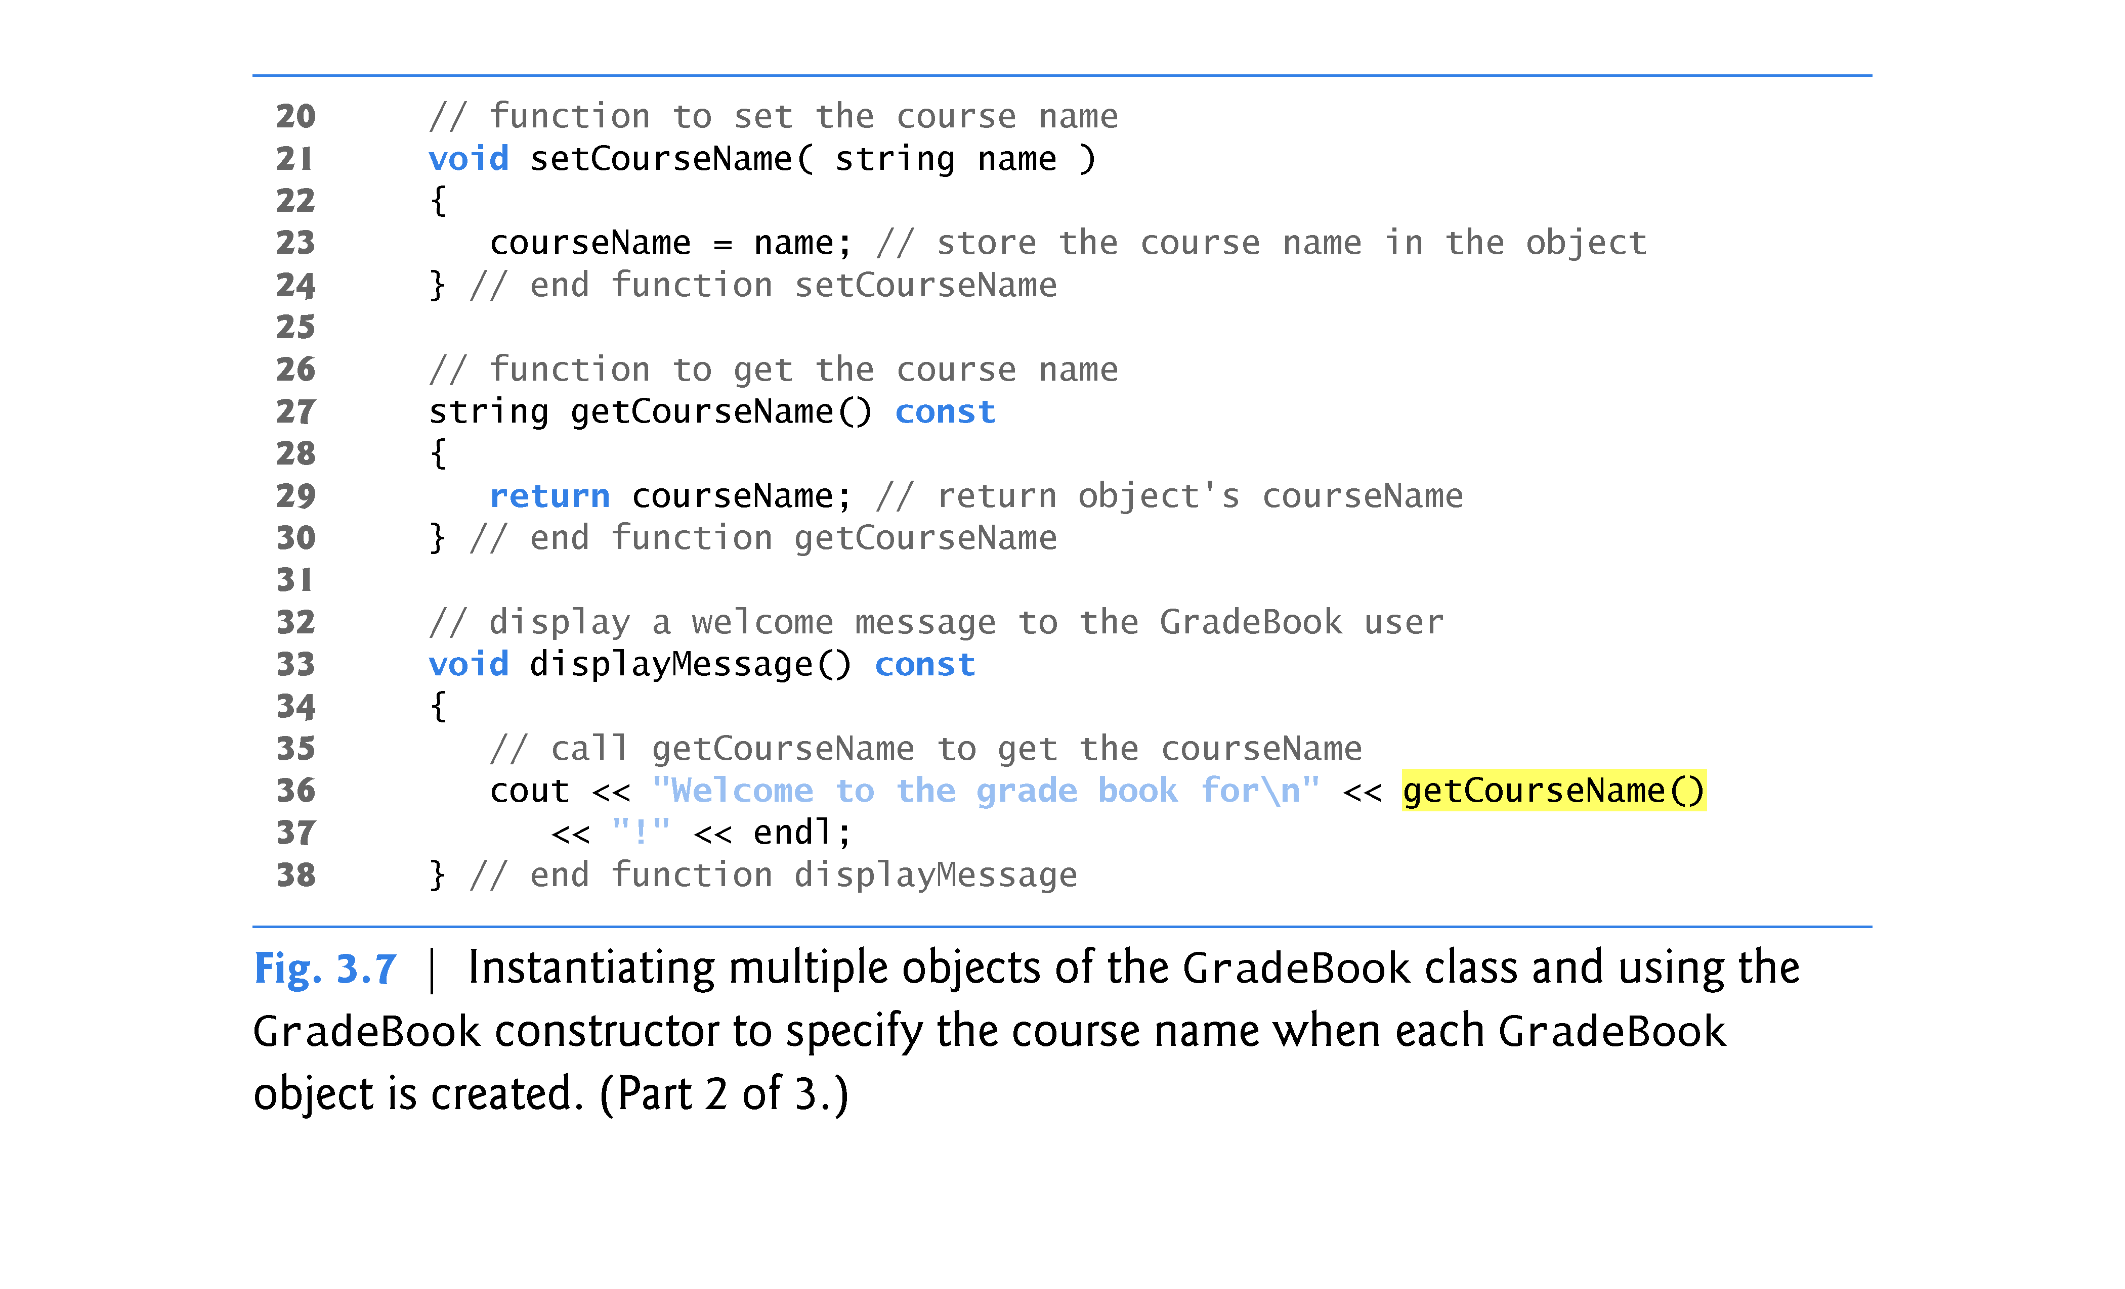

Slide 14
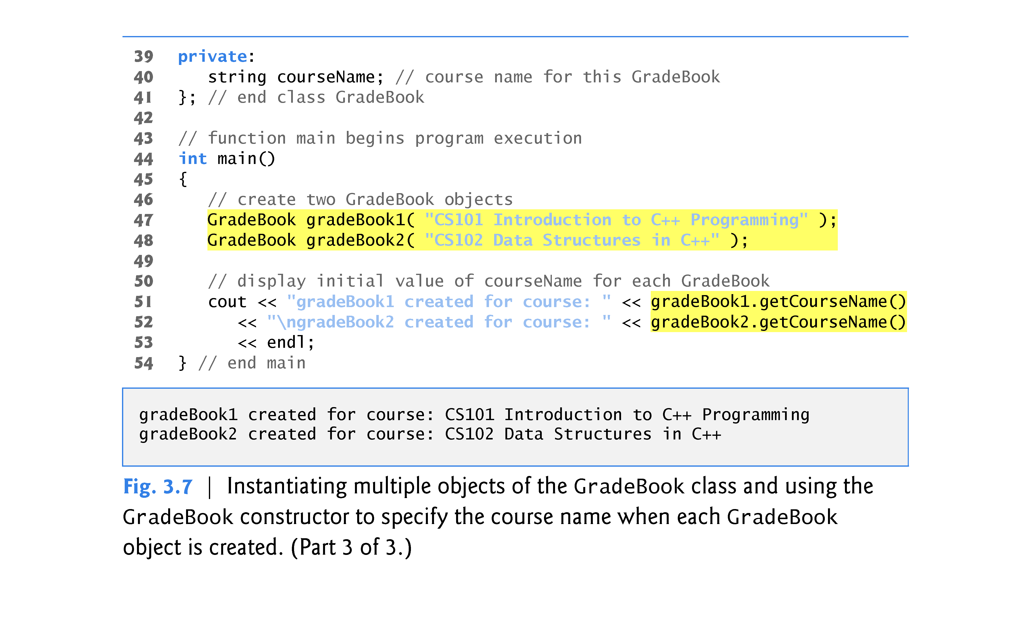

Slide 15
3.5 Initializing Objects with Constructors (cont.)
A constructor specifies in its parameter list the data it requires to perform its task.
When you create a new object, you place this data in the parentheses that follow the object name.
The constructor uses a member-initializer list (line 15) to initialize the courseName data member with the value of the constructor’s parameter name.
Member initializers appear between a constructor’s parameter list and the left brace that begins the constructor’s body.
The member initializer list is separated from the parameter list with a colon (:).

Slide 16
3.5 Initializing Objects with Constructors (cont.)
A member initializer consists of a data member’s variable name followed by parentheses containing the member’s initial value.
In this example, courseName is initialized with the value of the parameter name.
If a class contains more than one data member, each data member’s initializer is separated from the next by a comma.
The member initializer list executes before the body of the constructor executes.

Slide 17
3.5 Initializing Objects with Constructors (cont.)
Any constructor that takes no arguments is called a default constructor.
A class gets a default constructor in one of several ways:
The compiler implicitly creates a default constructor in every class that does not have any user-defined constructors.
The default constructor does not initialize the class’s data members, but does call the default constructor for each data member that is an object of another class. An uninitialized variable contains an undefined (“garbage”) value.
You explicitly define a constructor that takes no arguments. Such a default constructor will call the default constructor for each data member that is an object of another class and will perform additional initialization specified by you.
If you define any constructors with arguments, C++ will not implicitly create a default constructor for that class.

Slide 18
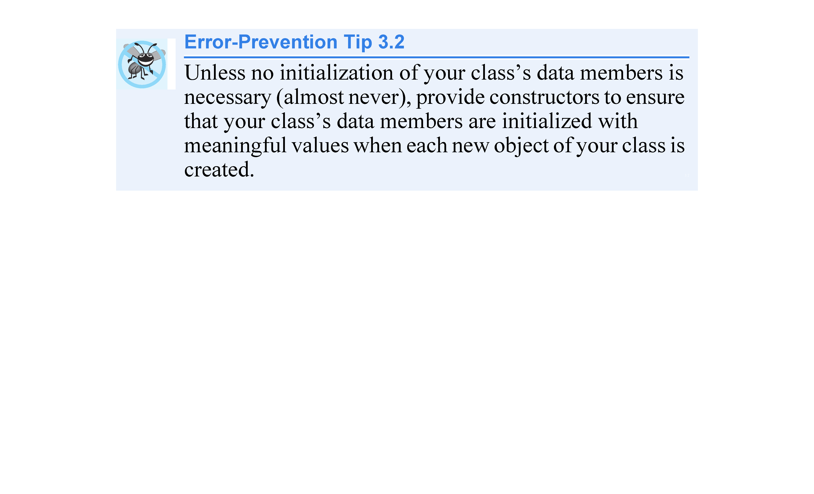

Slide 19
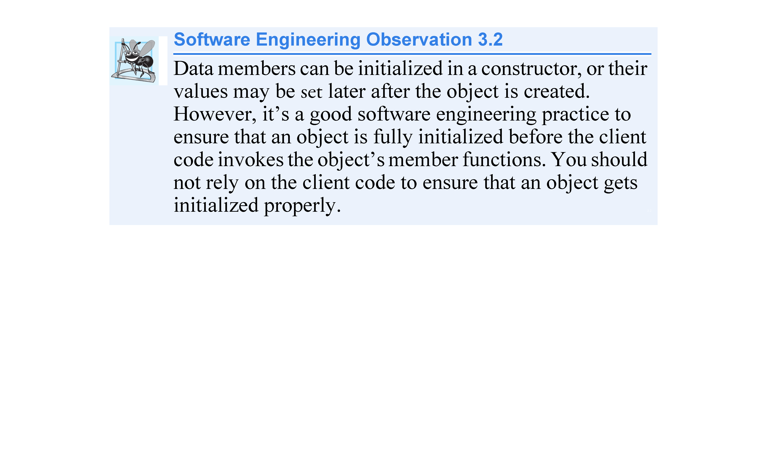

Slide 20
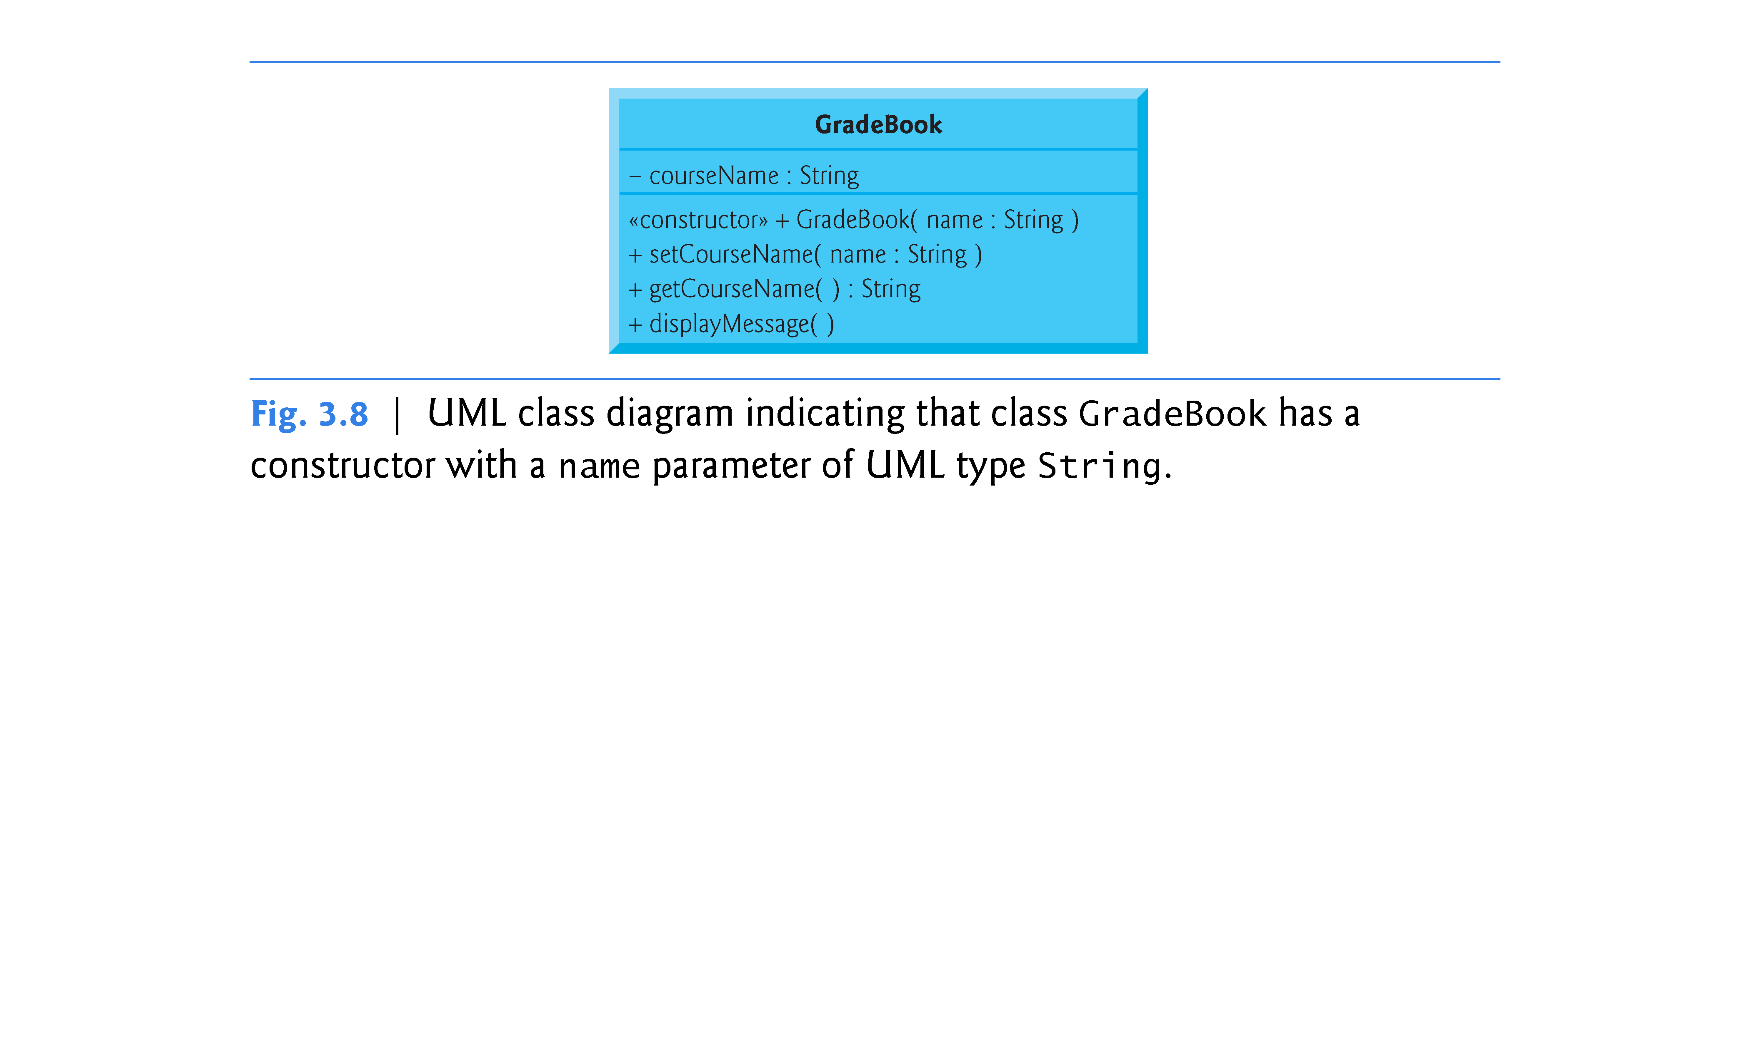

Slide 21
3.6 Placing a Class in a Separate File for Reusability
One of the benefits of creating class definitions is that, when packaged properly, our classes can be reused by programmers - potentially worldwide.
Programmers who wish to use our GradeBook class cannot simply include the file from Fig. 3.7 in another program.
As you learned in Chapter 2, function main begins the execution of every program, and every program must have exactly one main function.

Slide 22
3.6 Placing a Class in a Separate File for Reusability (cont.)
Each of the previous examples in the chapter consists of a single .cpp file, also known as a source-code file, that contains a GradeBook class definition and a main function.
When building an object-oriented C++ program, it’s customary to define reusable source code (such as a class) in a file that by convention has a .h filename extension—known as a header.
Programs use #include preprocessing directives to include header files and take advantage of reusable software components.

Slide 23
3.6 Placing a Class in a Separate File for Reusability (cont.)
Our next example separates the code from Fig. 3.7 into two files - GradeBook.h (Fig. 3.9) and fig03_10.cpp (Fig. 3.10).
As you look at the header file in Fig. 3.9, notice that it contains only the GradeBook class definition (lines 7–38) and the headers on which the class depends.
The main function that uses class GradeBook is defined in the source-code file fig03_10.cpp (Fig. 3.10) in lines 8–18.
To help you prepare for the larger programs you’ll encounter later in this book and in industry, we often use a separate source-code file containing function main to test our classes (this is called a driver program).

Slide 24
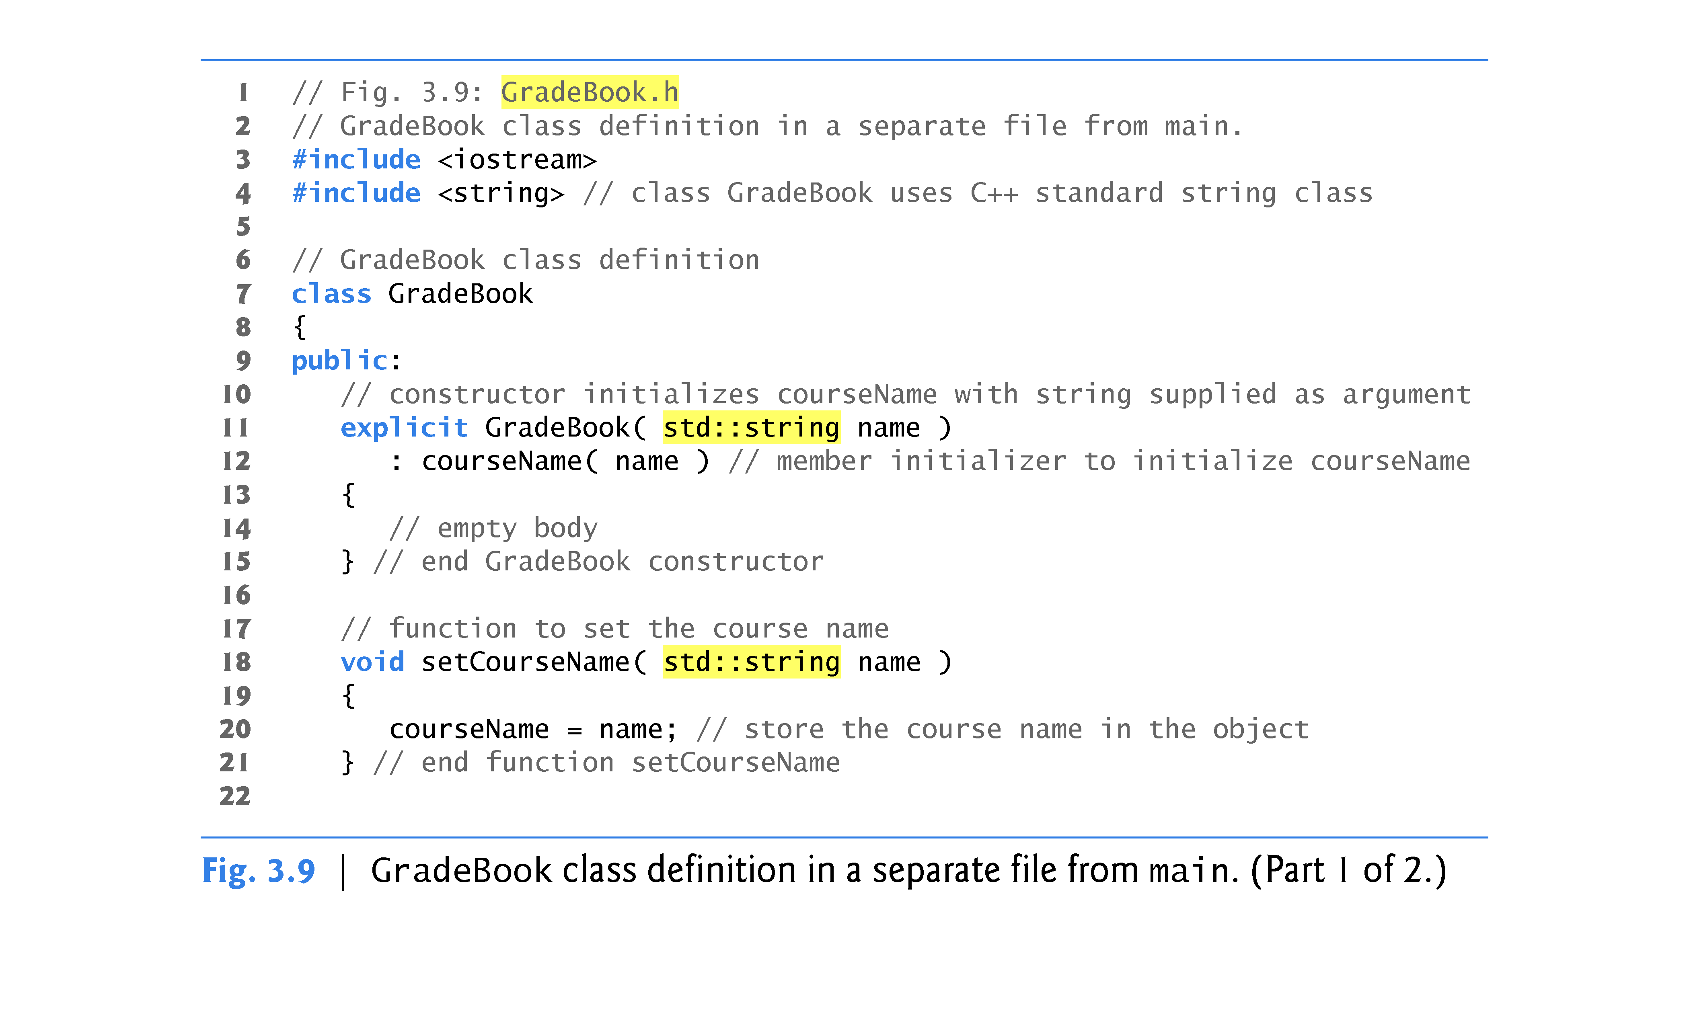

Slide 25
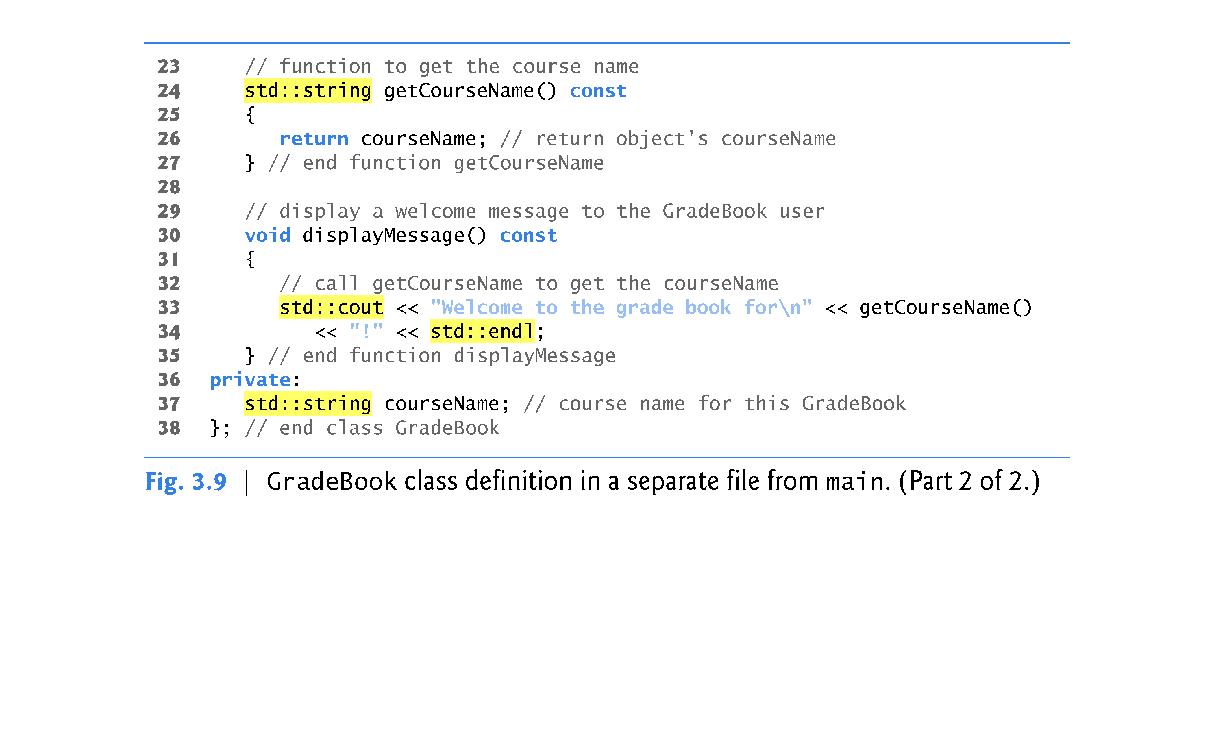

Slide 26
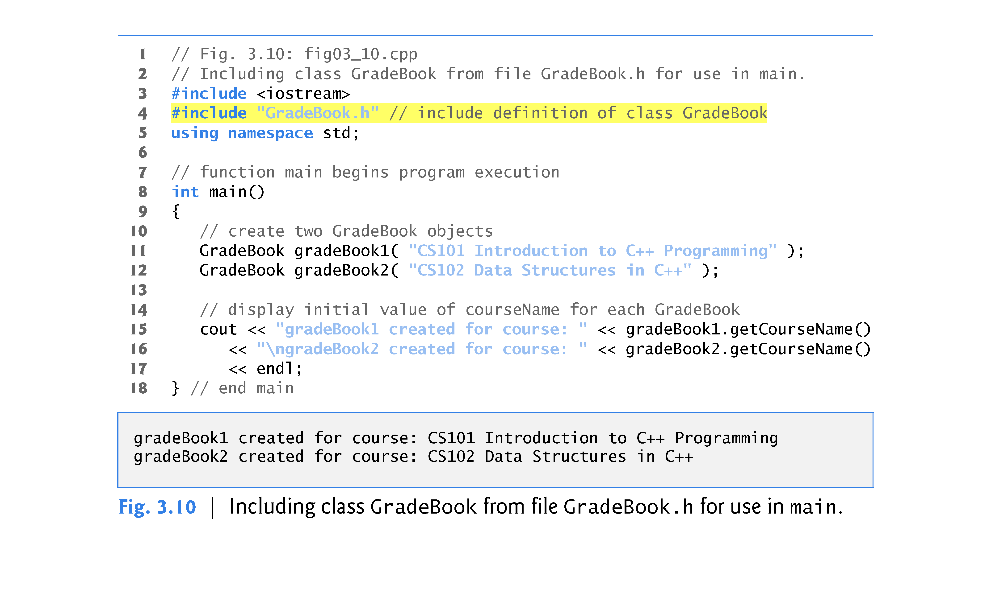

Slide 27
3.6 Placing a Class in a Separate File for Reusability (cont.)
Throughout the header (Fig. 3.9), we use std:: when referring to string (lines 11, 18, 24 and 37), cout (line 33) and endl (line 34).
Headers should never contain using directives or using declarations (Section 2.7).
To test class GradeBook (defined in Fig. 3.9), you must write a separate source-code file containing a main function (such as Fig. 3.10) that instantiates and uses objects of the class.

Slide 28
3.6 Placing a Class in a Separate File for Reusability (cont.)
To help the compiler understand how to use a class, we must explicitly provide the compiler with the class’s definition (declaration…)
That’s why, for example, to use type string, a program must include the <string> header file.\
This enables the compiler to determine the amount of memory that it must reserve for each object of the class and ensure that a program calls the class’s member functions correctly.

Slide 29
3.6 Placing a Class in a Separate File for Reusability (cont.)
The compiler creates only one copy of the class’s member functions and shares that copy among all the class’s objects.
Each object, of course, needs its own data members, because their contents can vary among objects.
The member-function code, however, is not modifiable, so it can be shared among all objects of the class.
Therefore, the size of an object depends on the amount of memory required to store the class’s data members.
By including GradeBook.h in line 4, we give the compiler access to the information it needs to determine the size of a GradeBook object and to determine whether objects of the class are used correctly.

Slide 30
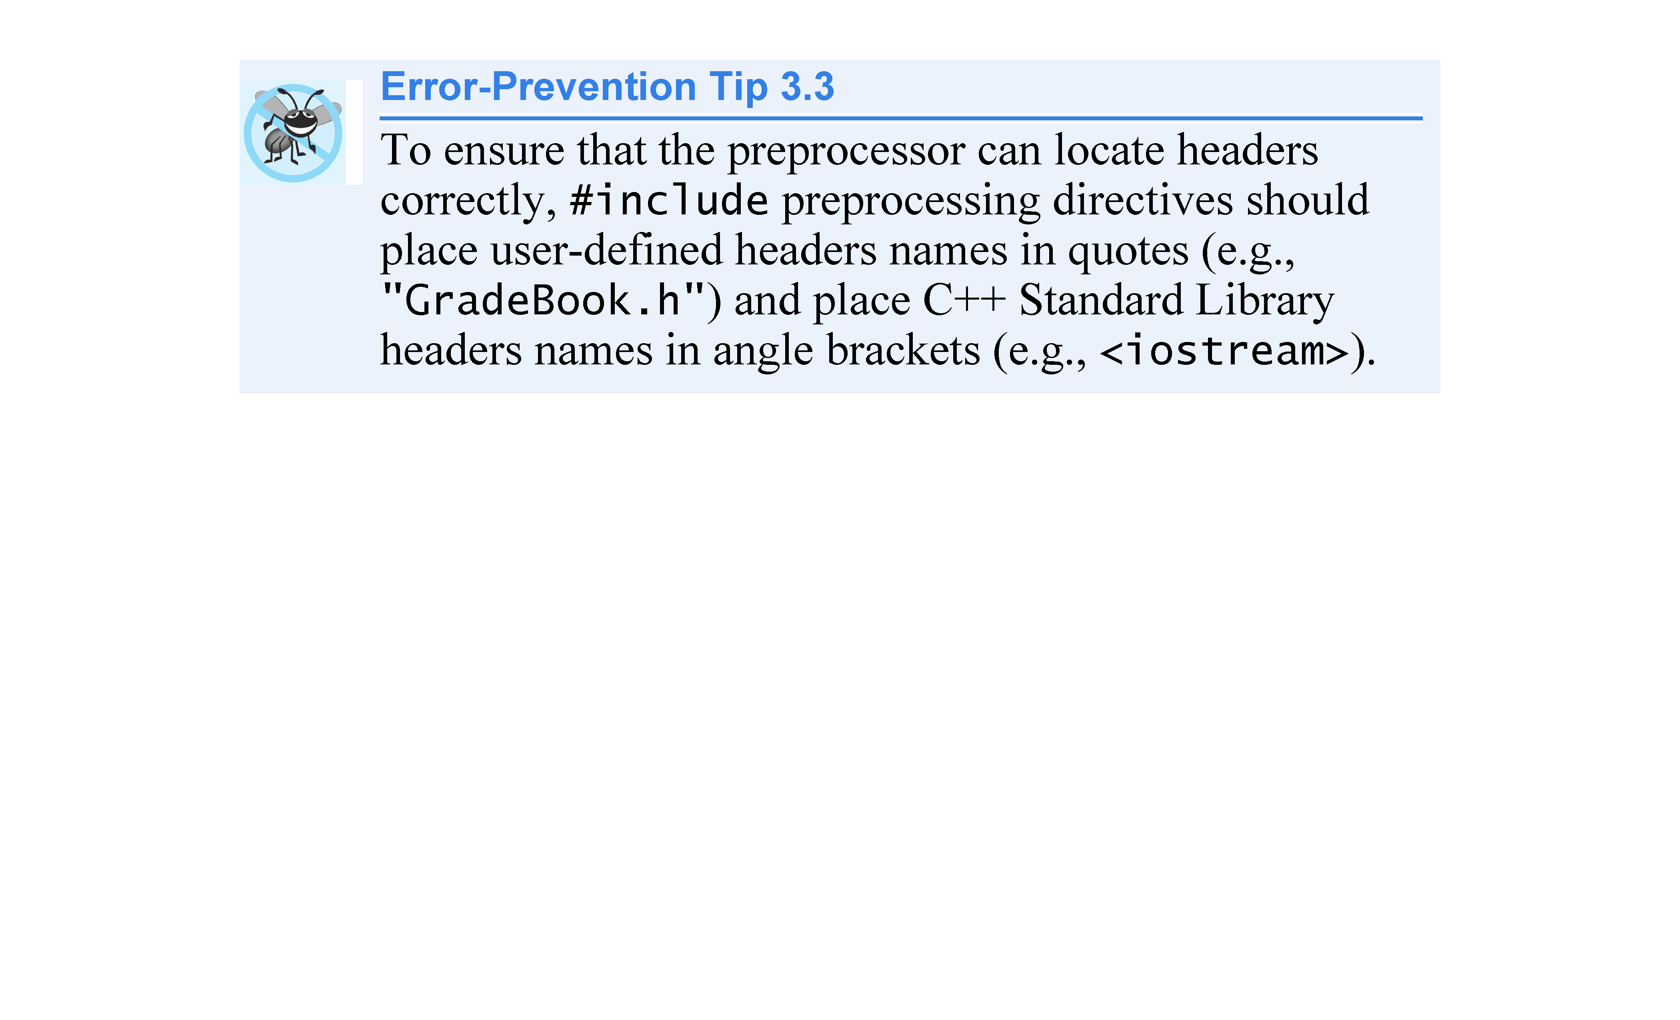

Slide 31
3.6 Placing a Class in a Separate File for Reusability (cont.)
Placing a class definition in a header file reveals the entire implementation of the class to the class’s clients.
Conventional software engineering wisdom says that to use an object of a class, the client code needs to know only what member functions to call, what arguments to provide to each member function and what return type to expect from each member function.
The client code does not need to know how those functions are implemented.
If client code does know how a class is implemented, the client-code programmer might write client code based on the class’s implementation details.
Ideally, if that implementation changes, the class’s clients should not have to change.
Hiding the class’s implementation details makes it easier to change the class’s implementation while minimizing, and hopefully eliminating, changes to client code.

Slide 32
3.7 Separating Interface from Implementation
Interfaces define and standardize the ways in which things such as people and systems interact with one another.
The interface of a class describes what services a class’s clients can use and how to request those services, but not how the class carries out the services.
A class’s public interface consists of the class’s public member functions (also known as the class’s public services).

Slide 33
3.7 Separating Interface from Implementation (cont.)
In our prior examples, each class definition contained the complete definitions of the class’s public member functions and the declarations of its private data members.
It’s better software engineering to define member functions outside the class definition, so that their implementation details can be hidden from the client code.
Ensures that you do not write client code that depends on the class’s implementation details.
The program of Figs. 3.11–3.13 separates class GradeBook’s interface from its implementation by splitting the class definition of Fig. 3.9 into two files—the header file GradeBook.h (Fig. 3.11) in which class GradeBook is defined, and the source-code file GradeBook.cpp (Fig. 3.12) in which GradeBook’s member functions are defined.

Slide 34
3.7 Separating Interface from Implementation (cont.)
By convention, member-function definitions are placed in a source-code file of the same base name (e.g., GradeBook) as the class’s header file but with a .cpp filename extension.
Figure 3.14 shows how this three-file program is compiled from the perspectives of the GradeBook class programmer and the client-code programmer. We’ll explain this figure in detail.

Slide 35
3.7 Separating Interface from Implementation (cont.)
Header file GradeBook.h (Fig. 3.11) is similar to the one in Fig. 3.9, but the function definitions in Fig. 3.9 are replaced here with function prototypes (lines 11–14) that describe the class’s public interface without revealing the class’s member-function implementations.
A function prototype is a declaration of a function that tells the compiler the function’s name, its return type and the types of its parameters.
Including the header file GradeBook.h in the client code (line 5 of Fig. 3.13) provides the compiler with the information it needs to ensure that the client code calls the member functions of class GradeBook correctly.

Slide 36
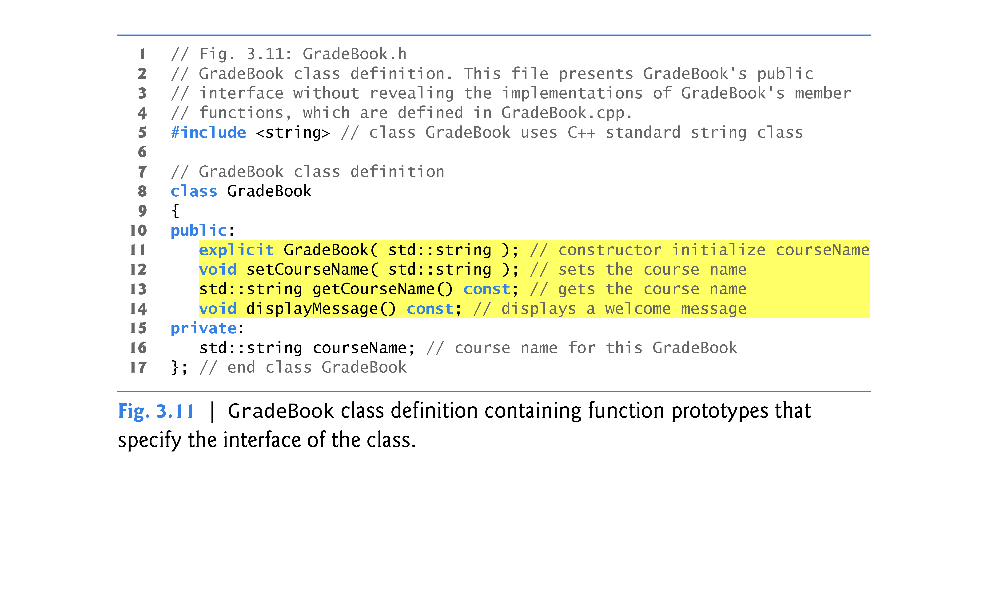

Slide 37
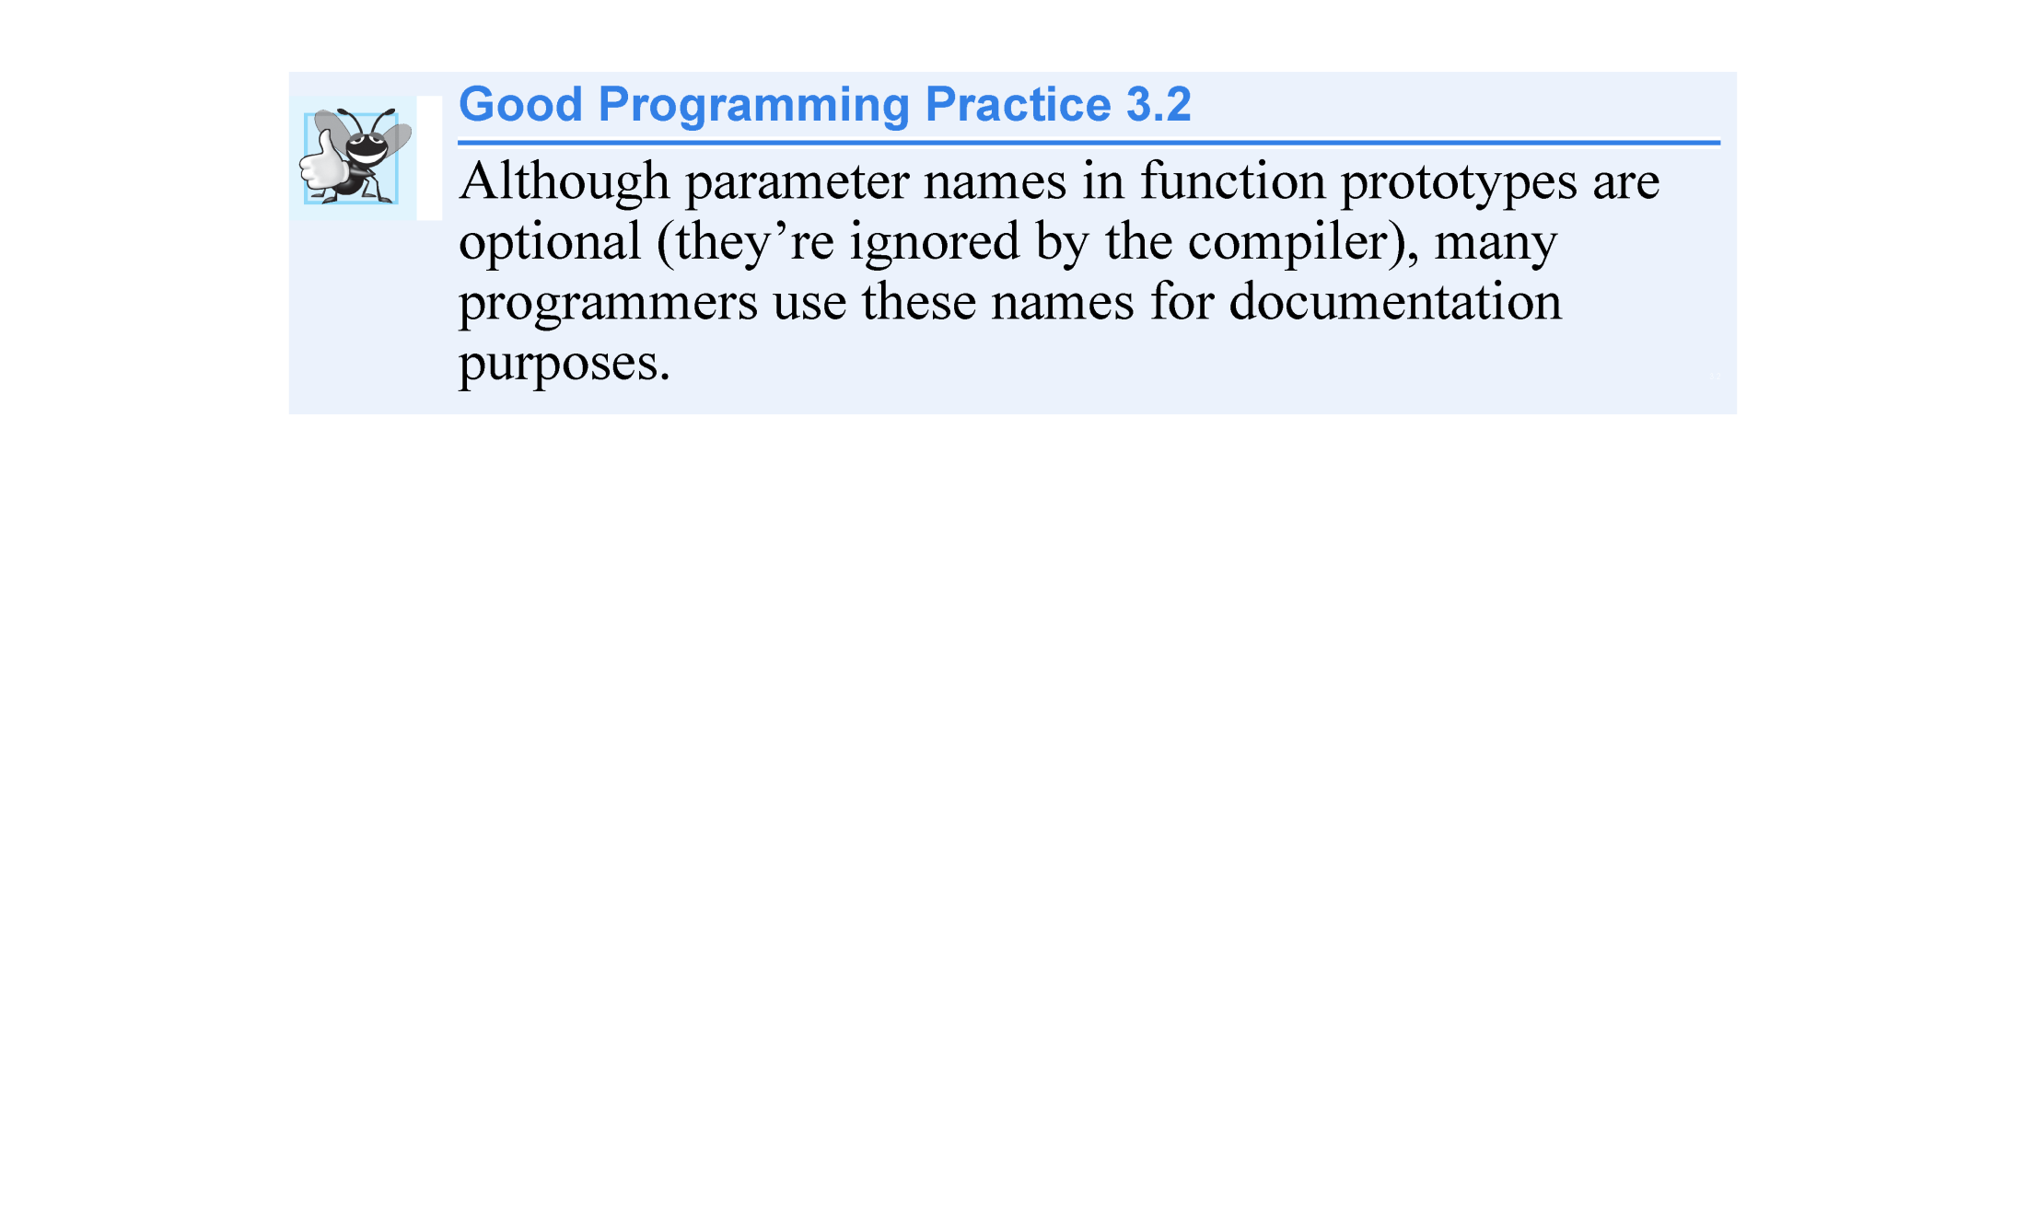

Slide 38
3.7 Separating Interface from Implementation (cont.)
Source-code file GradeBook.cpp (Fig. 3.12) defines class GradeBook’s member functions, which were declared in lines 11–14 of Fig. 3.11.
Each member-function name (lines 9, 16, 22 and 28) is preceded by the class name and ::, which is known as the scope resolution operator.
This “ties” each member function to the (now separate) GradeBook class definition (Fig. 3.11), which declares the class’s member functions and data members.

Slide 39
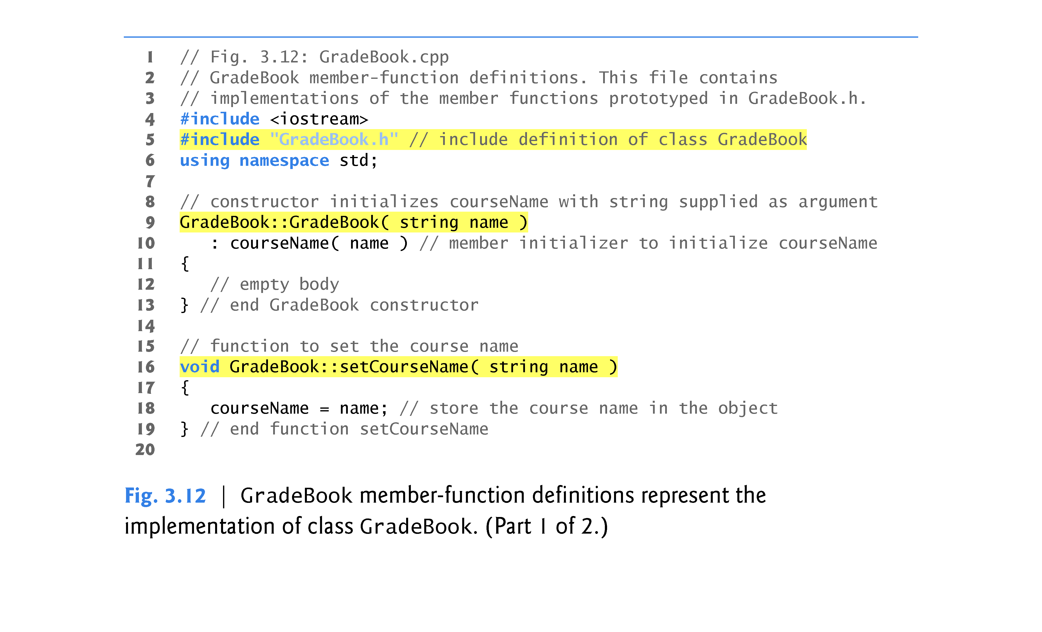

Slide 40
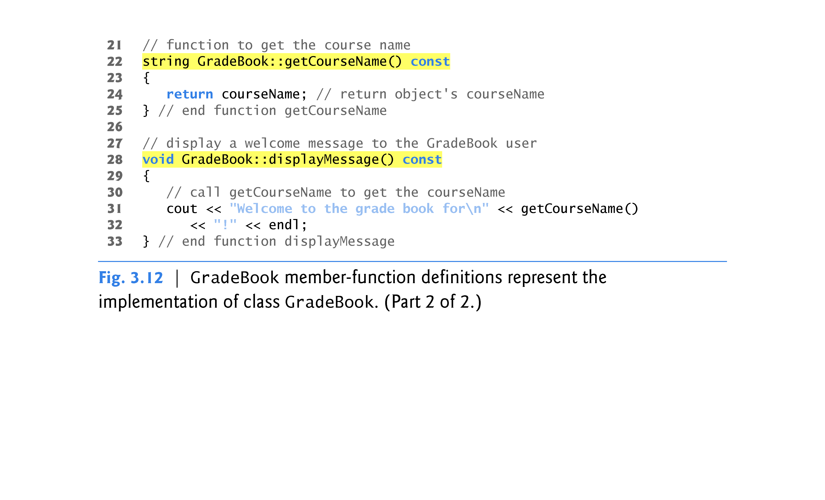

Slide 41
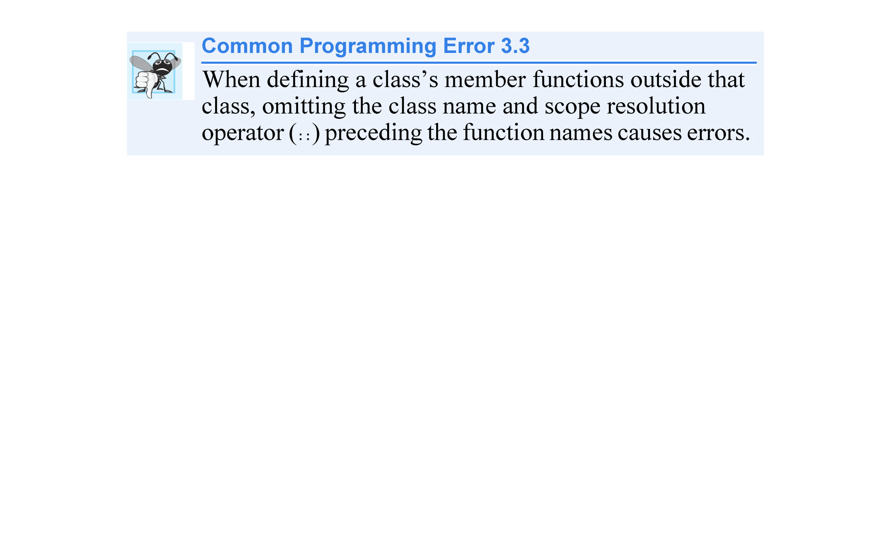

Slide 42
3.7 Separating Interface from Implementation (cont.)
To indicate that the member functions in GradeBook.cpp are part of class GradeBook, we must first include the GradeBook.h header file (line 5 of Fig. 3.12).
This allows us to access the class name GradeBook in the GradeBook.cpp file.
When compiling GradeBook.cpp, the compiler uses the information in GradeBook.h to ensure that:
the first line of each member function matches its prototype in the GradeBook.h file
each member function knows about the class’s data members and other member functions

Slide 43
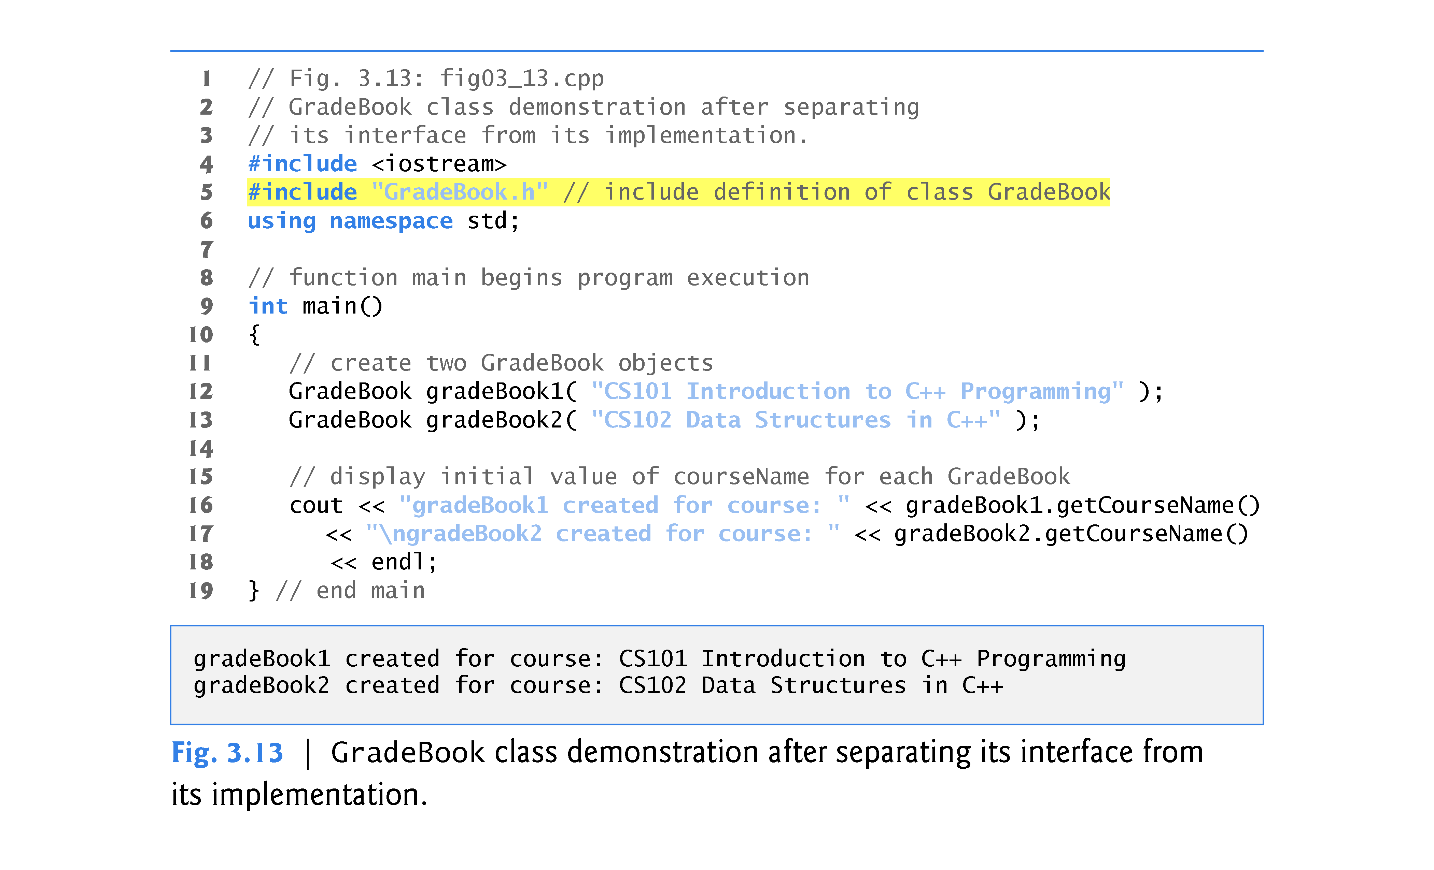

Slide 44
3.7 Separating Interface from Implementation (cont.)
Before executing this program, the source-code files in Fig. 3.12 and Fig. 3.13 must both be compiled, then linked together—that is, the member-function calls in the client code need to be tied to the implementations of the class’s member functions – a job performed by the linker.
The diagram in Fig. 3.14 shows the compilation and linking process that results in an executable GradeBook application that can be used by instructors.

Slide 45
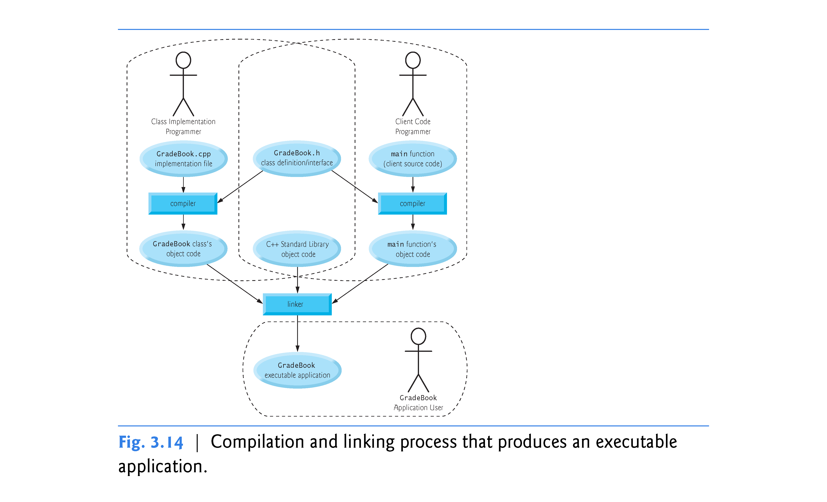

Slide 46
3.8 Validating Data with set Functions
The program of Figs. 3.15–3.17 enhances class GradeBook’s member function setCourseName to perform validation (also known as validity checking).
Since the interface of the class remains unchanged, clients of this class need not be changed when the definition of member function setCourseName is modified.
This enables clients to take advantage of the improved GradeBook class simply by linking the client code to the updated GradeBook’s object code.

Slide 47
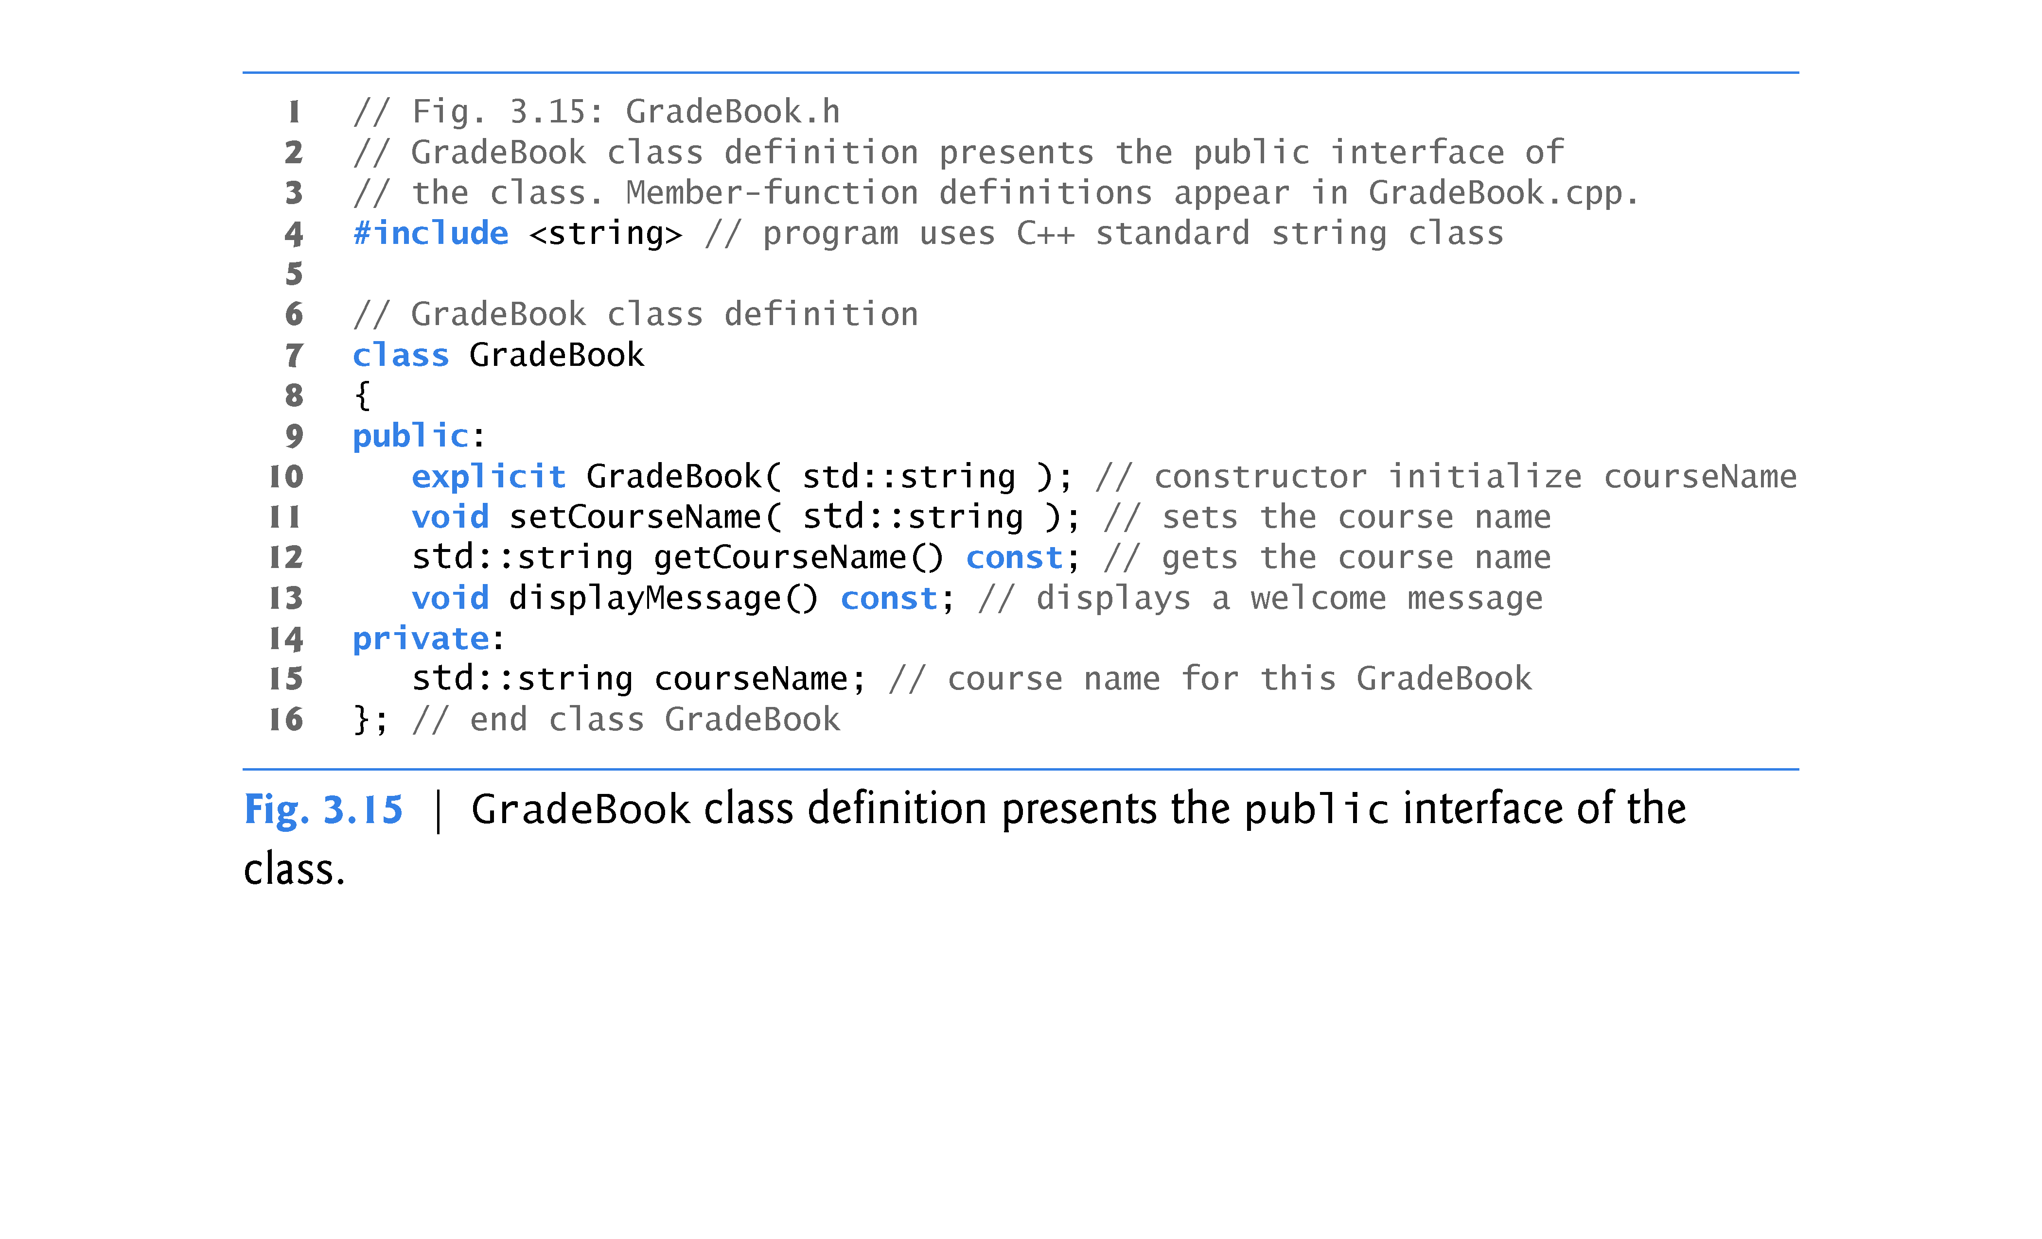

Slide 48
3.8 Validating Data with set Functions (cont.)
The C++ Standard Library’s string class defines a member function length that returns the number of characters in a string object.
A consistent state is a state in which an object’s data members contain valid values (not garbage).
Class string provides member function substr (short for “substring”) that returns a new string object created by copying part of an existing string object.
The first argument specifies the starting position in the original string from which characters are copied.
The second argument specifies the number of characters to copy.

Slide 49
3.10 Validating Data with set Functions (cont.)
Figure 3.17 demonstrates the modified version of class GradeBook (Figs. 3.15–3.16) featuring validation.
In previous versions of the class, the benefit of calling setCourseName in the constructor was not evident.
Now, however, the constructor takes advantage of the validation provided by setCourseName.
The constructor simply calls setCourseName, rather than duplicating its validation code.

Slide 50
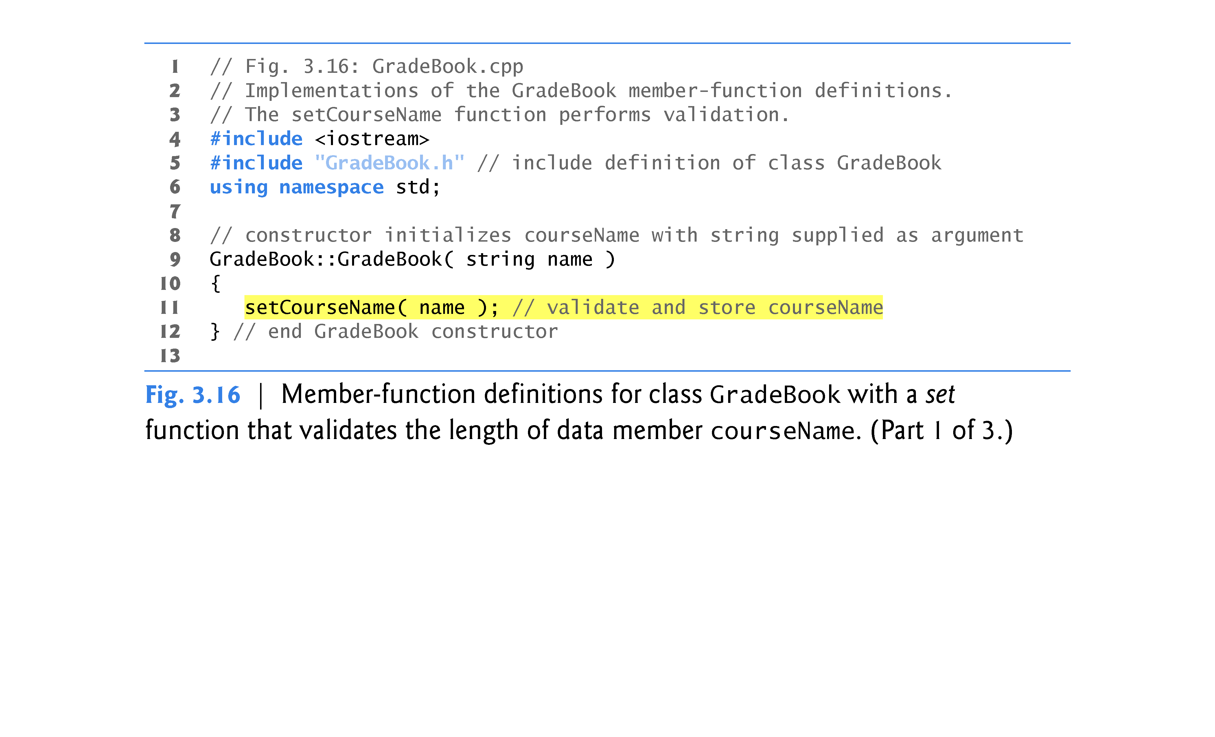

Slide 51
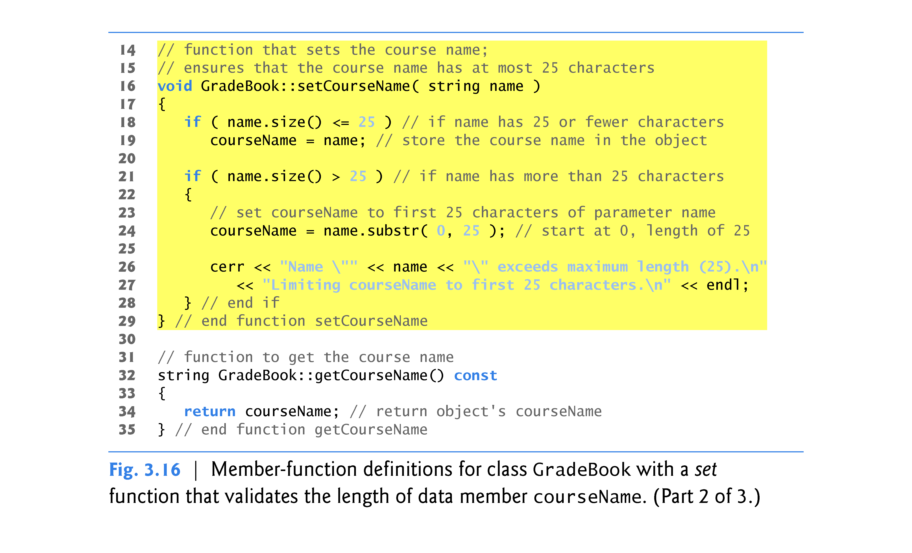

Slide 52
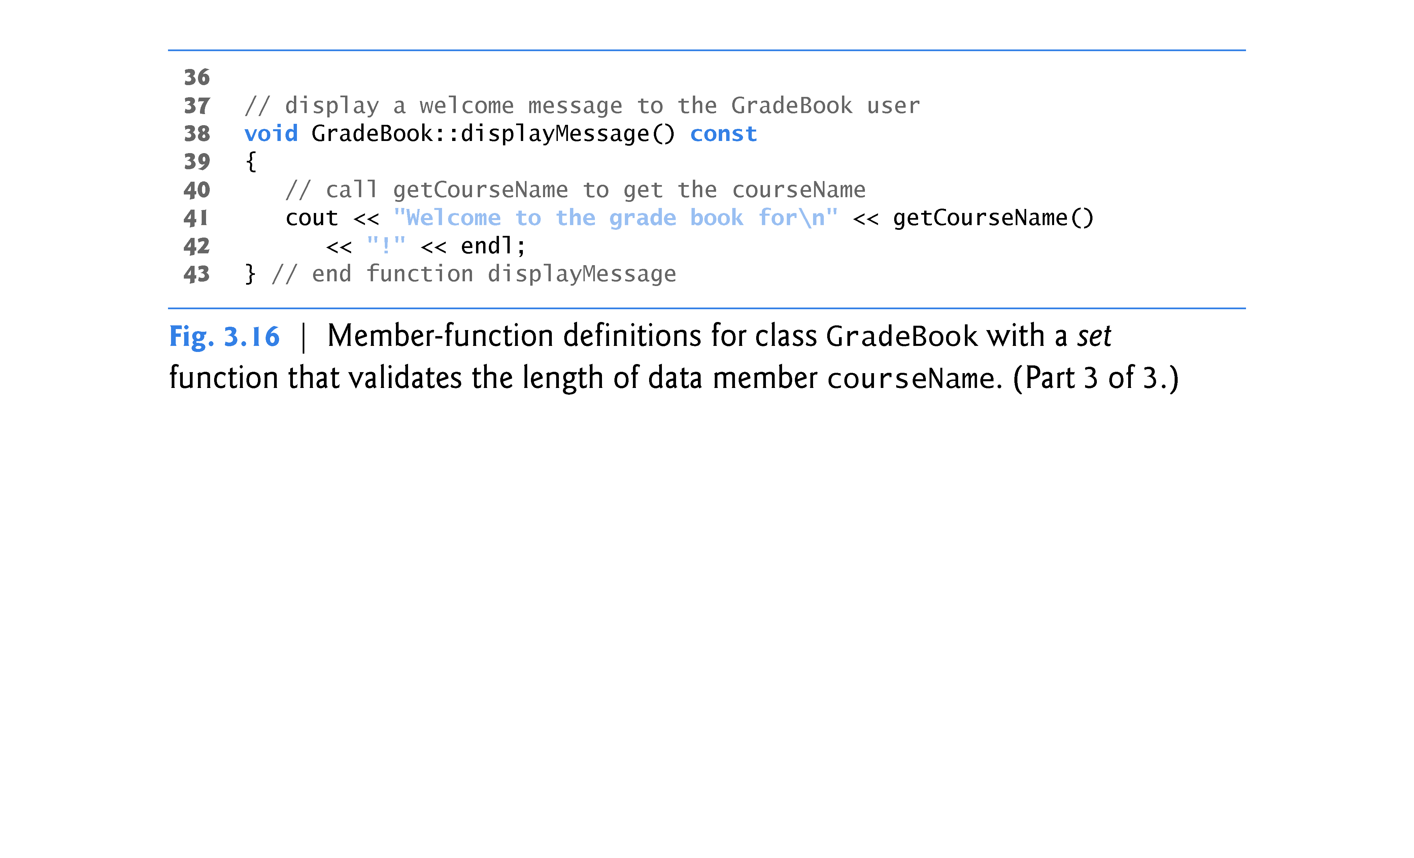

Slide 53
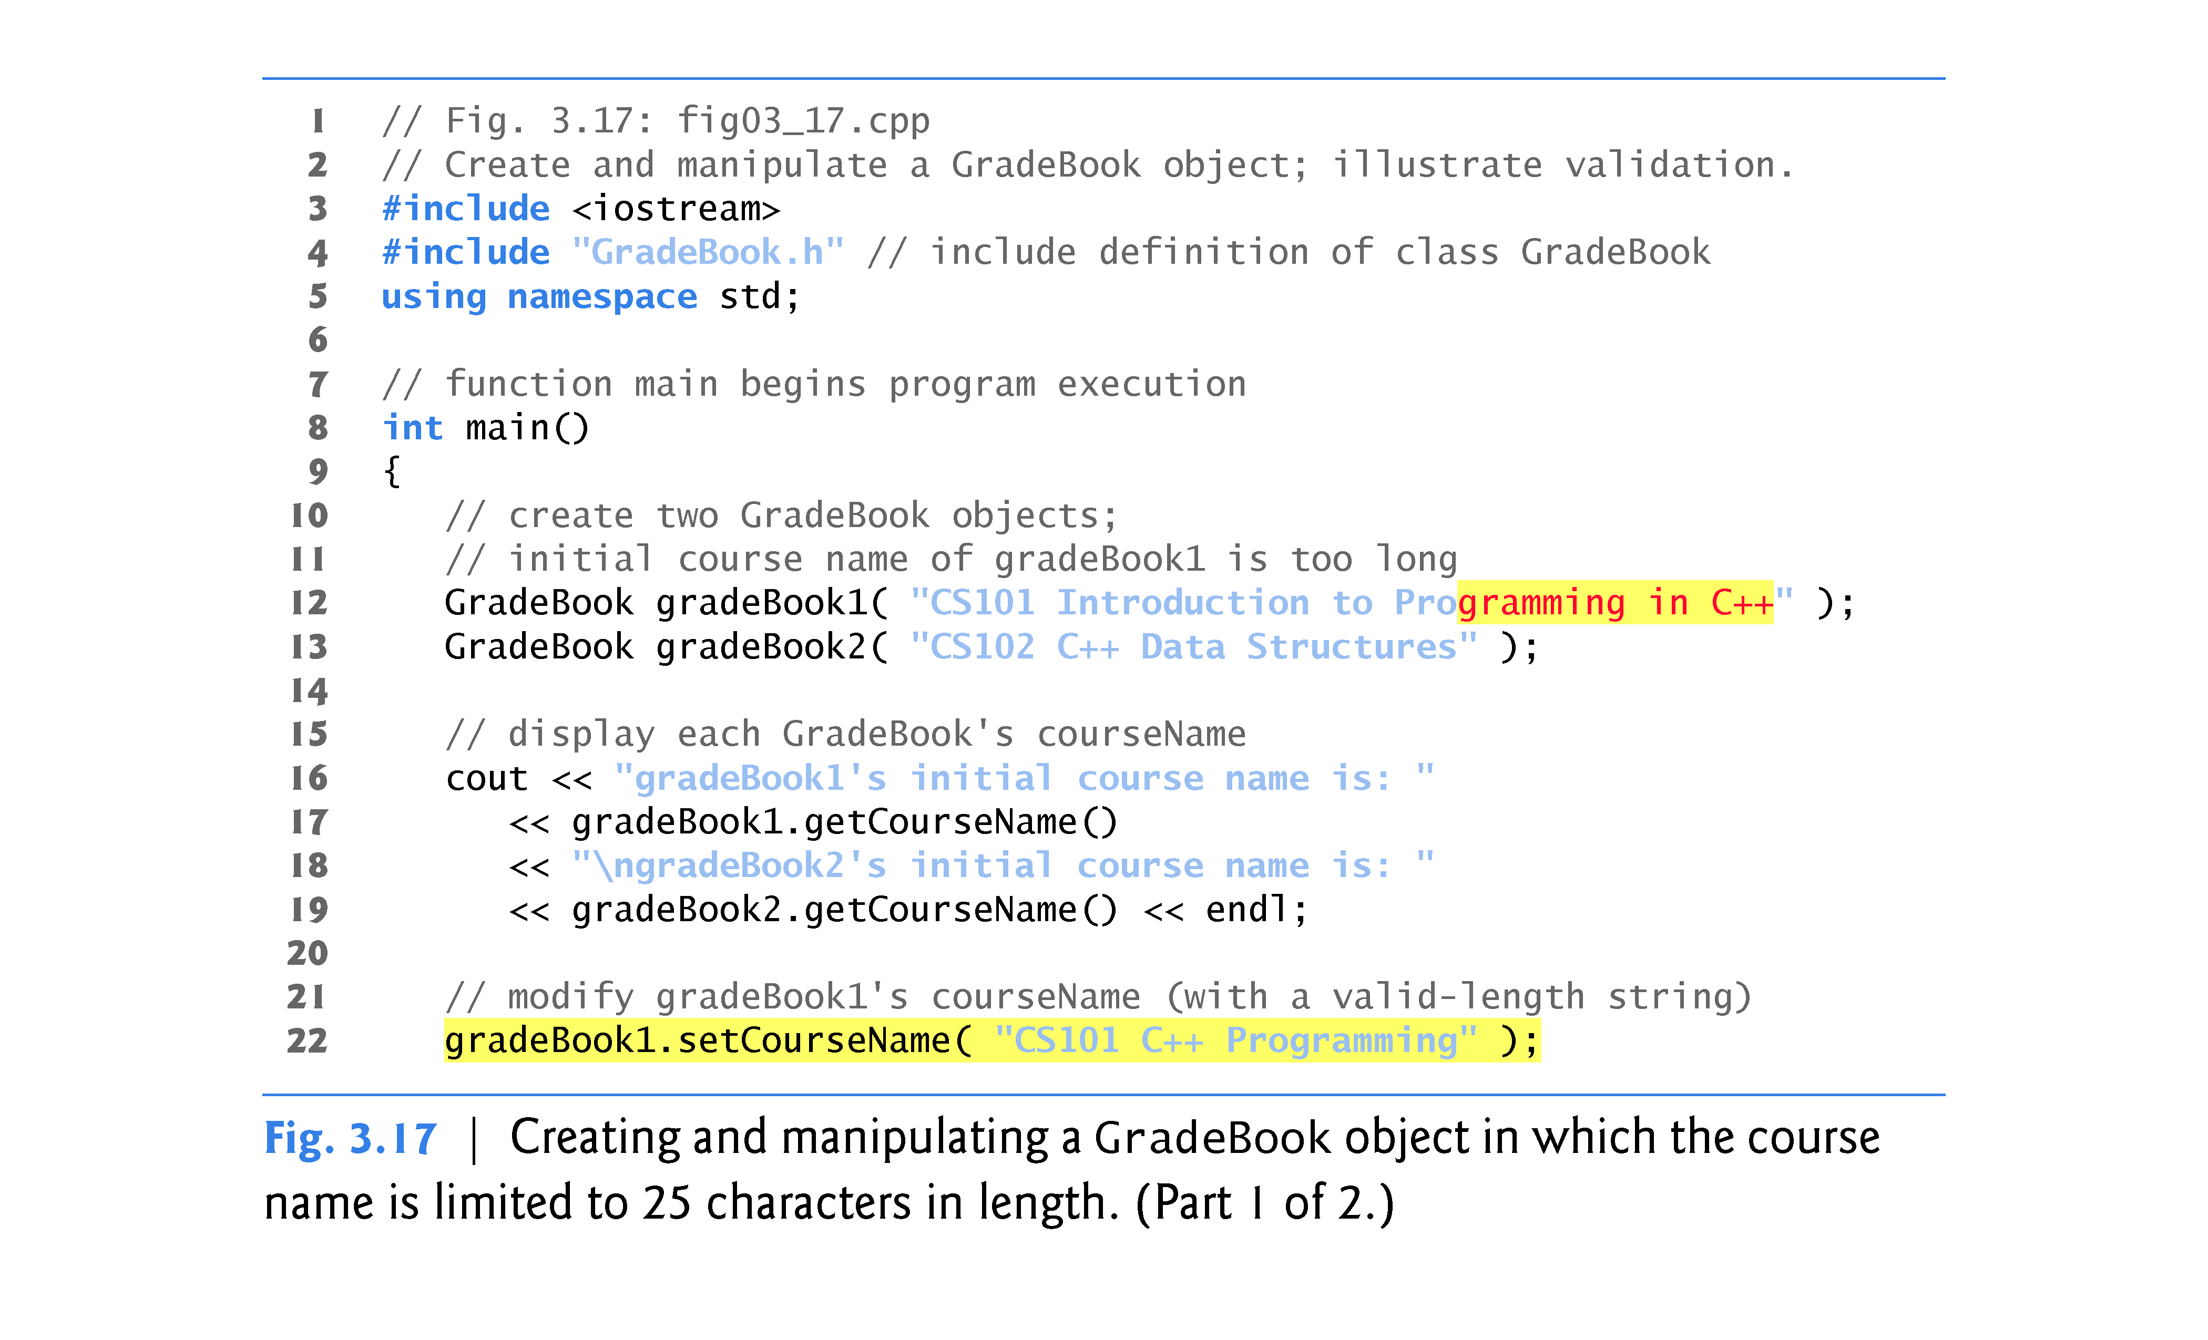

Slide 54
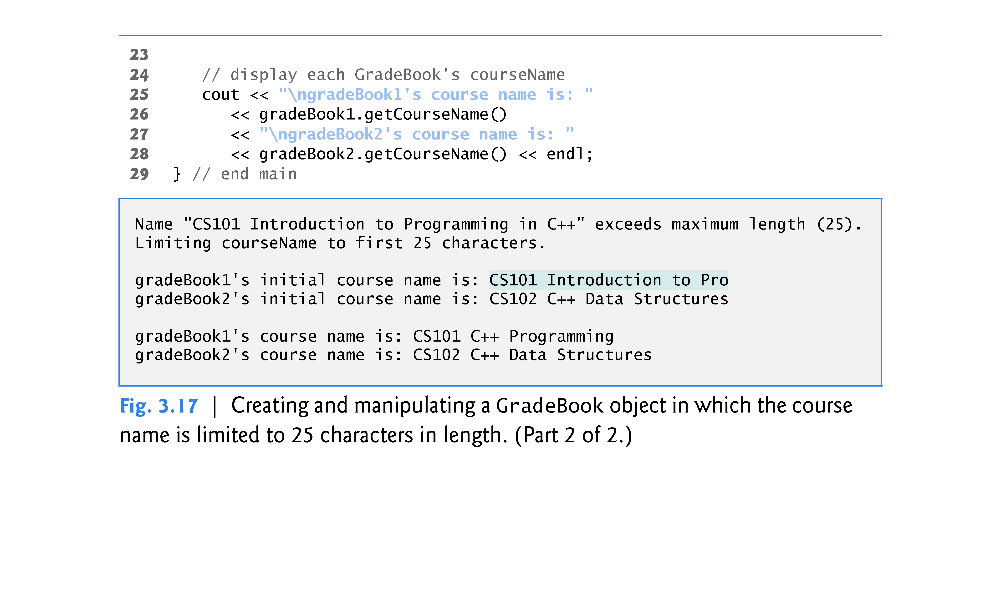

Slide 55
3.8 Validating Data with set Functions (cont.)
A public set function such as setCourseName should carefully scrutinize any attempt to modify the value of a data member (e.g., courseName) to ensure that the new value is appropriate for that data item.
A set function could return a value indicating that an attempt was made to assign invalid data to an object of the class.
A client could then test the return value of the set function to determine whether the attempt to modify the object was successful and to take appropriate action if not.

Slide 56
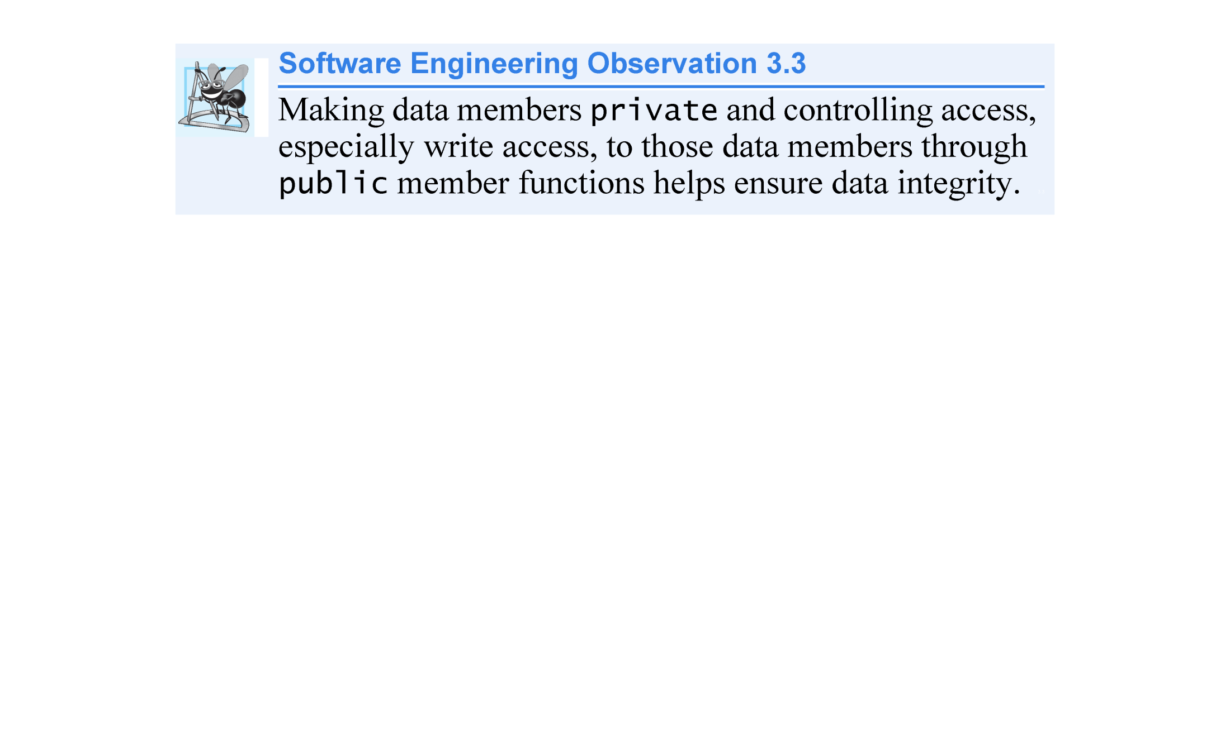

Slide 57
